Slide 1


SECure CURRICULUM AND VET .TRAINING PACKAGE
MODULE 6
Early Warning Systems

Slide 2
Why is our SECure CURRICULUM and VET TRAINING PACKAGE special ?
The SECure CURRICULUM AND VET TRAINING PACKAGE is the first holistic VET approach to address early crisis detection and resolution based on a framework specifically developed for SMEs. It does this by combining a curricula-based approach, which can be adopted in teaching and training by VET, with a modular approach, which is particularly useful for consultants and for use directly by SMEs and founders.
CC BY-SA 4.O

Slide 3
MODULE 01
THE FUNDAMENTALS
Based on the findings of the SECure International Early Warning System Learning Framework (IO1) , the SECure VET Package and learning model has been designed across six engaging training modules:-
What is a business crisis and what are early detection mechanisms?
Knowing when –an overview of the 3 phases on SME/business crisis - main stages, the pre-crisis, the management and response stage itself and the post-crisis
MODULE 02
A CRISIS THAT COMES FROM EXTERNAL UNAVOIDABLE FACTORS
You did not see this coming, it’s not usually something you’re prepared for, but once it happens, you wish you were, e.g. natural crisis, weakening economy and calamities, market environment e.g., supply chains , technology related issues .
MODULE 03
A CRISIS THAT COMES FROM INTERNAL FACTORS
Management skills and culture,
Product sales crisis, Customer base, dependency, relationships.
Data systems and tools of internal and external analysis within the business
Earnings and liquidity crisis
Operational crisis
Technology deficits – lack of skills and resources
Organisational/personnel crisis
MODULE 04
LEADERSHIP CULTURE, STAKEHOLDER MANAGEMENT AND COMMUNICATIONS
MODULE 05
UNDERSTANDING FINANCIAL AND LIQUIDITY RATIOS & INSOLVENCY AS A RESTRUCTURING APPROACH
MODULE 06
EARLY WARNING SYSTEMS
As an SME with limited resources, how can you implement early warning systems that enable you to detect crises at an early stage before they take on dimensions that threaten the company's existence.

Slide 4
Despite ongoing turbulent economic times, businesses have been slow to embrace setting up early warning systems
01
Introduction to an Early Warning System (EWS) and the SECure Assessment Tool
MODULE 06
02
“To know thyself is the beginning of Wisdom” - Socrates
.This final module will challenge learners to consider that a crisis can be avoided by taking countermeasures, at the appropriate time. The development of an Early Warning System can help lessen the impact of crisis episodes and provide a systematic approach to the response of small business owners to challenges in their business environment.
What does “good” Risk Management look like?
03

Slide 5
01
INTRODUCTION

Slide 6

What is an Early Warning System (EWS)?
This final modules brings together our earlier learning from other modules.
The components of an effective warning system should include:
risk awareness (prior knowledge) - Module 1
monitoring and warning service for early warning, communication (dissemination of warnings) - Modules 2,3, 4 and 5
response capability (act by all partners of the information chain) – Modules 4 and 5
An EWS represents the set or series of information needed to generate and disseminate timely and meaningful warning information that enables at-risk businesses to prepare and act appropriately and in sufficient time to reduce harm or loss (Chaves and De Cola (2017).
The difference between the design, use and output of an EWS, will include aspects such as the precision, reliability, and accuracy as well as the type of variables required (Koyuncugil and Ozgulbas, 2012)

Slide 7
Obstacles to an EWS
Naturally, many businesses are concerned about the expense of setting up early warning systems . However, these systems can established quite simply and be scaled to the company’s resources. And if and when a serious incident occurs, such a system is likely to pay for itself quickly.
SMEs and different business functions often keep information in silos. It can be hard to get people to share inside information with other departments. Often they fear that by doing so, they will lose a measure of control.
Management cannot agree on which severity matrix to use. It’s common for different departments in the same organization to each have their own incident severity matrix. For example, facilities might use a matrix where a Level 1 event is minor and Level 4 means the world is ending, while the sales department at the same company might use a color-coded system going from green to red.
EWSs can be used to detect crises before damage has been made and for reducing false alarms of possible crisis. We propose that the problem is not the crisis itself, but its early detection and the development of suitable counter strategies and measures i.e. the later the crisis is recognised, the faster the scope for action decreases.

Slide 8
SECure designs practice-oriented early warning indicators
The set of indicators were developed using bottom-up, expert-centric design principles. We focused on information needed by SMEs and entrepreneurs to identify and deal with an emerging crisis.
This set of indicators and emergent EWS is innovative because it is one of the first practice-oriented study on (qualitative) early warning indicators in small business.
A key decision was to align the EWS to a credible academic model, after some deliberation a consensus emerged that Porter’s Value Chain model (1985) adapted to the small business sector would be utilised.
The set of indicators would be connected to a questionnaire that provide questions that test quantitative indicators as well as qualitative indicators.
FIND OUT MORE ABOUT PORTER'S VALUE CHAIN. READ
What is Porter’s Value Chain Model And Why It Matters In Business - FourWeekMBA
Porter's Value Chain - Explained - The Business Professor, LLC

Slide 9

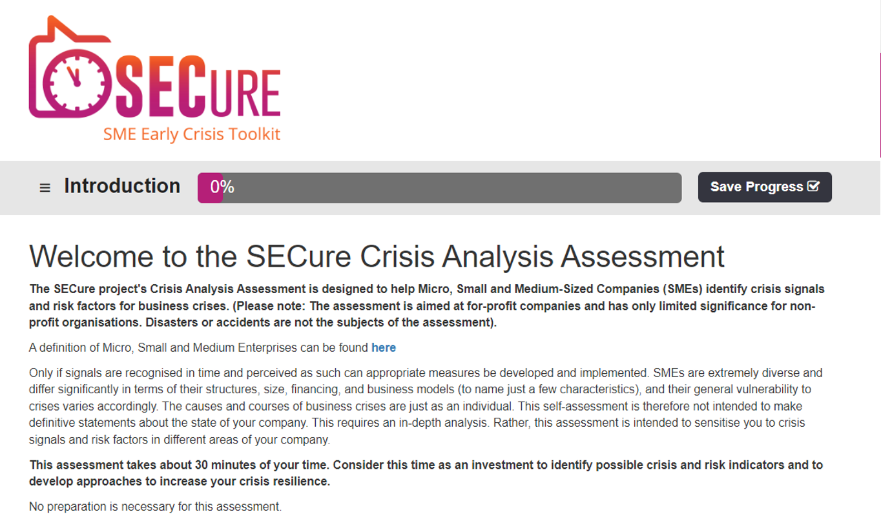
What is an Early Warning System (EWS)?
CLICK TO VIEW
While an EWS is used in the financial markets (and of course in other aspects of our lives such as for environmental purposes, in the health sector and extensively in financial credit), it is less prevalent as an embedded tool with SMEs.
This is despite its value. So, the SECure team have developed SME specific tools. Have you seen/tried our SECure interactive assessment? It will help in the identification of risk and early warning indicators for business crises. Uniquely, it also provides comprehensive individualised feedback

Slide 10
Key Indicators within an EWS
Human Resource Management - management practices and management of people in the company including planning and control.
Technology - Products/services, new product development and technology in the company.
Procurement - Purchasing practices, supplier dependency and production planning.
Logistics – supply chain, logistics management and technology.
Operations and project management planning and technology and quality management.
01
02
03
04
05

Slide 11
Key Indicators within an EWS
Marketing and Sales - Market analytics and research, customer dependency, sales trends, customer communication and relationships.
Market Environment - Nature of the market in terms of competition and competitiveness.
Finances and Control - Financial results, product/service profitability, liquidity/cash flow, loans/debt and financial indicators/ratios.
Personal Wellbeing -Work life balance, access to coaching/mentoring.
06
07
08
09

Slide 12
How an Early Warning System might detect risk
Porter's Value Chain is used to identify where the value/success factors of an organisation lie within primary and supporting activities. In this way, competitive advantage can be made visible. Of course, you can use the same structure to identify early warning indicators for corporate crises.
In any company, risks and causes of crises can arise at any point in its value chain. It, therefore, is reasonable to monitor risks and early warning indicators along this value chain as well. The framework structures an ideal-typical company into different divisions according to activity groups.

Slide 13
How an Early Warning System might detect risk
01
Procurement
02
Technology, Products/ Services & Innovation
Supporting activities are activities that, as the name suggests, support the primary. Supporting
activities can be divided into four generic categories:
03
Human Resource Management
04
Firm Infrastructure

Slide 14
How an Early Warning System might detect risk
A company's infrastructure tends not to be directly associated with specific primary activities, but rather supports the value chain as a whole. Supporting activities can be understood as supporting building blocks of competitive advantages.
The sections of the questionnaire of this SECure assessment follow this basic structure. Sections are also grouped thematically in sub-sections. Points are awarded for each answer. Additionally, we have added perspectives and sections that are specifically relevant when it comes to crisis management:
01
Finances and Accounting
02
Market Environment
03
Personal Wellbeing

Slide 15
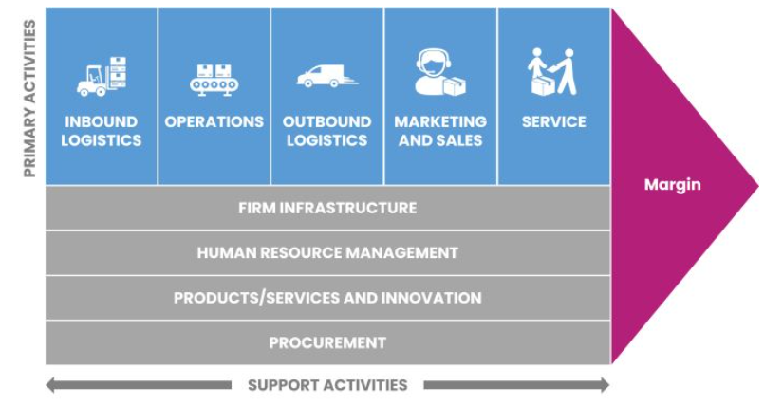
Brainstorming Risk Areas
KK The Methodology of our SECure Assessment
As we all know, no two companies are alike - and not all possible crisis indicators are equally relevant for all companies. For the structure of this assessment, we have chosen Porter's Value Chain, a framework that covers a wide range of company structures and business models, and at the same time has a certain international recognition.

Slide 16
How an Early Warning System might detect risk
Examples of factors that can contribute to a crisis in a small business setting with column three providing an indication of how an EWS might detect risk for the factor.
01
Internal Factors
02
External Factors
03
EWS

Slide 17
01
Internal Factors
03
EWS
Diversification
New market entry
Liquidity
Equipment
Staff Profile
Supply chain supply
Ratios of income per customer, over time with threshold levels to identify over- reliance.
Data on company registrations and ongoing review of new marketing activity.
Live data on income and expenditure with detailed projections.
Ongoing market research and analysis of tech and market-based reports
Live data on HR issues and review of national statistics and trends.
Metrics to measure reliance on suppliers or supply routes. Live data on commodity pricing
02
External Factors
Loss of major customer
Competition
Public Finance
Consumer Trends
Demographics
Resource shortages

Slide 18
Take the SECure Self Assessment as part of an Early Warning test
The SECure team led by international crisis management experts https://thevisionworks.de/ and guided by the team of ATU Donegal Letterkenny | ATU - Atlantic Technological University have developed a scoring algorithm that divides the scores of your answers in certain sections into three main categories:
Clear Warning Signals
There are clear warning signals and risk indicators in the respective area. You should urgently carry out an in-depth analysis of these areas and start working on countermeasures.
EXERCISE
Watch Out
You should examine the respective area in detail. There are some warning signs that have been identified based on your answers.
Monitor
Currently there appear to be no or just few warning signals in this area – but you should monitor changes

Slide 19
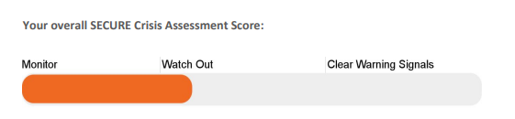
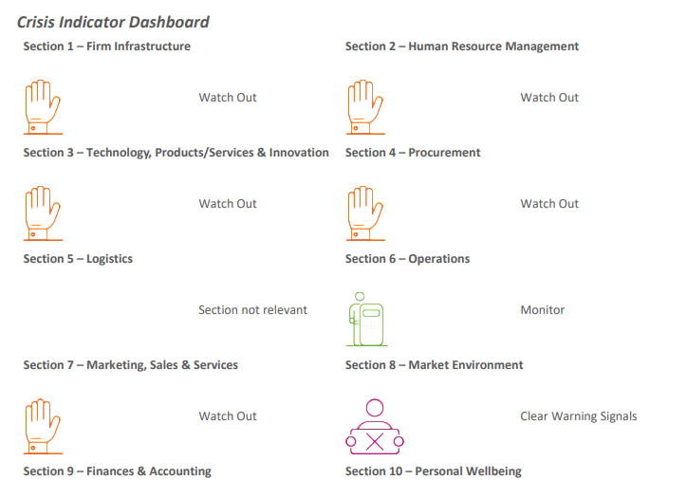
Take the SECure Self Assessment as part of an Early Warning test
The overall Crisis Assessment Score looks like this ……..
The Crisis Indicator Dashboard presents the rate for each of 10 assessment areas………
EXERCISE

Slide 20

Take the SECure Self Assessment as part of an Early Warning test
Curious to see what a SECure Crisis Analysis Assessment Report looks like?
EXERCISE
CLICK TO VIEW

Slide 21
02
“TO KNOW THYSELF IS THE BEGINNING OF WISDOM” –
SOCRATES

Slide 22
Great Business Outcomes and Great Risk Management are Two Sides of the Same Coin.
01
Mindset; Transforming Risk into Value
02
Structured Approach in an increasing risk universe
03
Interaction between Culture , Communications, Risk and Strategy
04
Tone at the Top / Psychological Safety
05
Communicating on Risk

Slide 23
Timing is Vital
Monthly Evaluations
Basic entrepreneurial concerns:
Where does my company stand financially today?
What are my cost drivers?
Where has my money gone?
First Step: Analyze Monthly Business evaluations
EWSs can be used to detect crises before damage has been made and for reducing false alarms of possible crisis
Let’s look at some Basic Controlling Mechanisms that will form a foundation of knowledge.

Slide 24
What KPIs are – and what not!
SME managers and teams can easily lose track of what is really important between all the goals and targets. They need few and simple key figures that tell them whether they are on track or not.
KPIS must meet basic requirements
Quantifiable / measurable and actionable
Measure factors that are critical to the success of the organization
Tied to business goals and targets
Limited to the real important metrics
Applied consistently throughout the company
What KPIs are not!
Metrics that are vague or unclear
“Nice to knows” or metrics that are not actionable
Reports
Exhaustive set of metrics
Refutable

Slide 25
5 Key Steps in the KPI Process
Depending upon the area of business performance being measured, the frequency with which KPIs need to be reviewed may differ. Accurate measurement of performance can only be obtained if a schedule of periodic review is defined and strictly adhered to.
01
Identify a set of relevant KPIs to track a company or business unit
02
Create Dashboards or scorecards to measure & display KPI results
03
Evaluate how well business goals are being met based on the KPIs
04
Change strategies and processes as needed to improve the performance
05
Assess whether the KPIs still align with goals and adjust them if needed

Slide 26
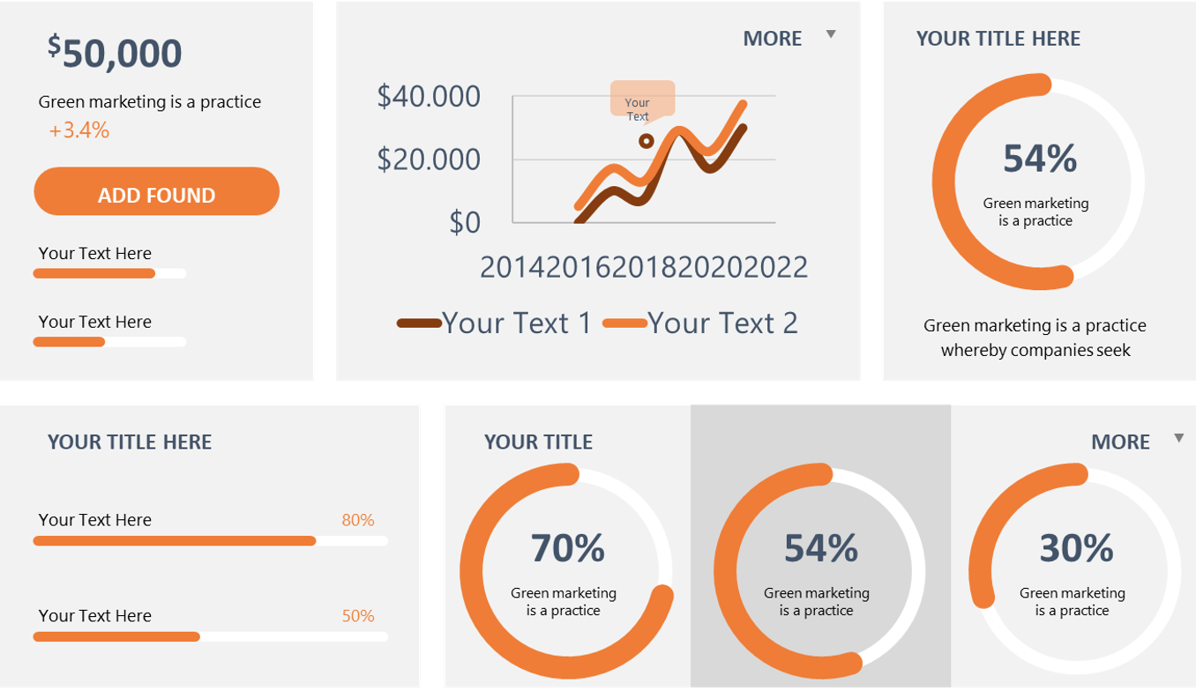
Benefits of using KPIs
The ultimate benefit of key performance indicators is the ability to measure the results of your actions, which are often undertaken based on assumptions. While research can help you make educated guesses and reduce your risks, it’s important to set key performance indicators, or KPIs, to help you increase or stop activities that create better- or worse-than-expected results. This allows you to take better decision, improve processes and improve your returns in the long term.

Slide 27
The absolute minimum you should monitor
01
Short-term liquidity planning / 3 Year Planning / 1 Year Forecast / Accounts Receivable / Accounts Payable
Interest, exchange rates
Raw Material prices / Stocks / Quality and Adherence to delivery dates of suppliers
Orders received / Business climate
/ Consumer sentiment
New process + technologies / Consumer behavior / Number of current development projects / Number of own patents/ Licenses granted / Research and development costs
02
By defining relevant observation areas and selecting suitable early detection indicators (see opposite), changes in the market and in the company can be systematically identified and monitored. By significantly changing an indicator, a signal is given to discuss and, if necessary, initiate measures.
There is a number of minimum areas you should constantly observe (in no particular order) …..
03
04
05

Slide 28
The absolute minimum you should monitor
06
Staffing Fluctuation / Sick Leave / Workforce Age Structure
Age Structure of Machines / Investment Backlog / Capacity Utilization / Energy Consumption / Scrap / Cost of poor Quality / Maintenance Costs
Number of enquiries per Period / Development of orders in your main industry (which will later affect your orders) / Revenues / Prices / Price and Product Strategy of your competitors / Lost Orders
07
By defining relevant observation areas and selecting suitable early detection indicators (see opposite), changes in the market and in the company can be systematically identified and monitored. By significantly changing an indicator, a signal is given to discuss and, if necessary, initiate measures.
There is a number of minimum areas you should constantly observe (in no particular order) …..
08

Slide 29
03
WHAT DOES “GOOD” RISK MANAGEMENT LOOK LIKE?

Slide 30
The benefits of Enterprise Risk Management (ERM)
The objective of risk management is to ensure uncertainty never deflects the endeavour from the established business goals.
The question now is, what does good Riska Management looks like?
Enterprise Risk Management (ERM)
Aligns organisation, people, processes and infrastructure, provides a benchmark for risk / reward, aids risk visibility to operational activities and for the more mature benefit, a competitive advantage.
Allows you to manage risks in an integrated manner – rather than separate risk silos
Elevates Risk Management as a strategic tool in achieving your goals and objectives
ADDITIONAL READING Risk Management 101 for SMEs

Slide 31

Why systematic risk identification?
A systematic approach is already crucial when identifying potential risks. It would be fatal if there were blind spots in risk management.
Should be part of business strategy process including strategic people planning
Effectiveness of horizon-scanning and scenario planning Really understanding the business eg organisational reviews
robustness of risk register information
Highlight & challenge embedded assumptions, blind spots
Stress-testing and learning loop

Slide 32
Brainstorming Risk Areas
Brainstorming Risk Areas
Identifying Risk Areas usually starts with a Brainstorming exercise. It is important to integrate the right team members or ask for external help.
Do we have gaps?
What will be required to comply?
3
4
Are we compliant in every area?
To what standards should we comply?
2
5
Brainstorming Risk Areas
Identify every compliance and risk area
How should we prioritise our efforts?
1
6

Slide 33

Brainstorming Risk Areas
What is a holistic view on risks?
“Holistic” is a term used in risk management to emphasize the importance of understanding the interrelationships among individual risks (or groups of related risks) and the coordinated approach that an organization's operating units and functions undertake to manage risk.
risk management

Slide 34
Brainstorming Risk Areas
Leadership Attitude is Key
Policies and procedures for predicting, evaluating and managing risk are important. But if leaders don’t ask the right questions, if they don’t seek out a diversity of opinions and perspectives, and if they don’t act with integrity, these rules won’t make any difference.
Self-awareness and role-modelling good leadership
Face up to, and learn from, mistakes
Who holds up the mirror?
Risk, HR, all functions?
Does that work currently?
Ensure good oversight of people strategy and risk
People insight and capabilities on the board?
be reflexive
engage with complexity
avoid knee-jerk
reactions –
‘pendulum effect’
be willing to challenge
and be challenged

Slide 35
Brainstorming Risk Areas
Integrating ERM into decision-making
To be effective, risk management must be integrated into day-to-day business line activities and corporate short-, mid- and long-term decisions. Integrating ERM and strategic planning can make strategic plans stronger while helping focus limited resources on the risks and issues that matter most.
Analysis of emerging risks and stress tests should influence business decisions
Risk Managers must be involved at the onset of strategy setting processes
04
03
02
Risk information should be shared across the company to avoid the same event recurring
01
Risks associated with new products should be considered and communicated to the board

Slide 36
Brainstorming Risk Areas
Risk Management Processes
Risk management processes are grouped in different ways but generally include the opposite.
Ideally, each of these processes should be ongoing rather than, for example, annual.
Report
Identify
Assess/ Measure
Monitor
Manage /
Respond

Slide 37
Brainstorming Risk Areas
The Risk Matrix
In order to have a clear overview about all the risks assessed, they are displayed in a 3-dimensional Risk Matrix – with the Risk impact on the X-Axis, the Likelihood on the Y-Axis and the Assurance score displayed by colours.
Insignificant
Minor
Moderate
Serious
Major
10
1-2
7-8
Highly Likely
R2
8
3-4
9-10
Likely
R5
5-6
6
Seldom
R4
4
Remote
R1
Color indicates
Assurance scores
where 1 is the
most effective
2
Unlikely
R3
2
4
6
8
10
Risk Impact

Slide 38

Sharing Data is Key
A strong data sharing/de-risking approach is to set up a cross-functional team and take steps to promote the sharing of data and information.
They can also establish one severity matrix (as per last slide) to be used by all departments across the business.
Such measures can provide even small business with an effective early warning system.

Slide 39
CONGRATULATIONS..
You have completed our SECure CURRICULUM and VET TRAINING PACKAGE.
www.facebook.com/SECure.ErasmusProject
www.twitter.com/SECure_Project
www.linkedin.com/company/secure-project/
www.smecrisistoolkit.eu

