Slide 1
SECure CURRICULUM AND VET .TRAINING PACKAGE
MODULE 3
A CRISIS that comes from INTERNAL FACTORS

Slide 2
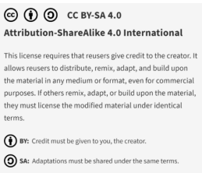
Why is our SECure CURRICULUM and VET TRAINING PACKAGE special ?
The SECure CURRICULUM AND VET TRAINING PACKAGE is the first holistic VET approach to address early crisis detection and resolution based on a framework specifically developed for SMEs. It does this by combining a curricula-based approach, which can be adopted in teaching and training by VET, with a modular approach, which is particularly useful for consultants and for use directly by SMEs and founders.

Slide 3
MODULE 01
THE FUNDAMENTALS
Based on the findings of the SECure International Early Warning System Learning Framework (IO1) , the SECure VET Package and learning model has been designed across six engaging training modules:-
What is a business crisis and what are early detection mechanisms?
Knowing when –an overview of the 3 phases on SME/business crisis - main stages, the pre-crisis, the management and response stage itself and the post-crisis
MODULE 02
A CRISIS THAT COMES FROM EXTERNAL UNAVOIDABLE FACTORS
You did not see this coming, it’s not usually something you’re prepared for, but once it happens, you wish you were, e.g. natural crisis, weakening economy and calamities, market environment e.g., supply chains , technology related issues .
MODULE 03
A CRISIS THAT COMES FROM INTERNAL FACTORS
Management skills and culture,
Product sales crisis, Customer base, dependency, relationships.
Data systems and tools of internal and external analysis within the business
Earnings and liquidity crisis
Operational crisis
Technology deficits – lack of skills and resources
Organisational/personnel crisis
MODULE 04
LEADERSHIP CULTURE, STAKEHOLDER MANAGEMENT AND COMMUNICATIONS
MODULE 05
UNDERSTANDING FINANCIAL AND LIQUIDITY RATIOS & INSOLVENCY AS A RESTRUCTURING APPROACH
MODULE 06
EARLY WARNING SYSTEMS
As an SME with limited resources, how can you implement early warning systems that enable you to detect crises at an early stage before they take on dimensions that threaten the company's existence.

Slide 4
A CRISIS that comes from INTERNAL FACTORS
Internal factors and risk management
01
MODULE 03
02
Risk management - management skills and culture, openness to innovation
03
Product sales crisis, a sudden drop in demand leading to loss
This module will introduce learners to crises that come from internal factors. Using problem-based learning approaches, learners will understand and apply mechanisms to respond to crisis that emerges from internal factors that puts the stability of the SME at risk.
04
Customer base, dependency, and relationships
05
Understanding the role and function of data systems and tools of internal and external analysis

Slide 5
A CRISIS that comes from INTERNAL FACTORS
MODULE 03
06
Earnings (bottom line or a company's profits) and liquidity crisis
07
Operational crisis
This module will introduce learners to crises that come from internal factors. Using problem-based learning approaches, learners will understand and apply mechanisms to respond to crisis that emerges from internal factors that puts the stability of the SME at risk.
08
Technology deficits – lack of skills and resources
09
Organisational / personnel crisis (human error and malpractice or intentional human-caused events)

Slide 6
On successful completion of this module the learner will be able to:
Recognise management skills and culture, and determine their openness to innovation
Explore the implications of a product sales crisis, resulting in a sudden drop in demand to loss
Understand the dynamics of customer base, dependency, and relationships
Identify and understand the role and function of data systems and tools of internal and external analysis within the business
Gain an understanding of earnings (bottom line or a company's profits) and liquidity crisis
Explore the key causes of an operational crisis
Recognize and mitigate technology deficits in terms of lack of skills and resources
Understand the dynamics of organisational/personnel crisis (human error and malpractice or intentional human-caused events that puts the stability of the SME at risk

Slide 7
01
Internal factors and risk management

Slide 8
Internal factors
The internal business environment comprises of factors within the company which impact the success and approach of operations. Unlike the external environment (Module 2), the company has control over these factors. While we know it is important to recognize potential opportunities and threats outside company operations, managing the strengths of internal operations is the key to business success.
The greatest thing about internal factors is that you have control over most of them. The three main internal factors are labour, finance, and technology. Let’s summarise these factors now before we delve deeper into each area later in this module.

Slide 9
Internal factors – Human Resources
Human resources (HR) relates to the people who work in/for the business. The performance of a business is affected by the quality and impact of the people who work for it. HR covers managers and employees
Managers can influence a business through:
decision-making Good decision making can increase productivity, increase profits and grow the business. Poor decisions could result in employees losing motivation, production being disrupted and complaints from customers.
creating policy - Managers create policies that aim to motivate employees and set realistic goals.
hiring and firing of employees - managers recruit new staff and let others go
setting budgets - managers will decide how much money a business can spend within a specific period.
conducting appraisals with staff - managers need to assess their staff to ensure they are working effectively.
Employees can influence a business through:
productivity
ability to satisfy customers
absenteeism
ability to perform their job
training
industrial action
Each of these areas of influence can impact positively or negatively on a business. Employees are the public face of a business. Badly performing employees will result in inferior products being produced and a poor service being offered to customers, with a negative effect on sales and the reputation of the business.
Human resources - Internal factors - National 5 Business management Revision - BBC Bitesize

Slide 10
Internal factors - finance
Financial risks depend on the financial structure of your business. It is also dependent on your business transactions and the financial systems. For example, changes in interest rates or being overly reliant on one customer could affect business. A business needs adequate funds in place in order for it to survive and grow successfully. Without the proper finance, a business will be held back and will eventually struggle to survive. Finance may be needed for several different reasons:
developing new products upgrading new software
a wage rise for existing employees hiring new staff
extending existing premises marketing and advertising
buying a new fleet of vehicles opening a new branch
buying new machinery and equipment
In some of these situations, finance will be required via a bank loan to be paid back with interest, a commercial mortgage, or a grant from the government. We reviewed the macro economic factors that hinder the availability of finance in Module 2.

Slide 11
Internal factors - technology
Businesses need up-to-date technology to keep up with customers’ ever-changing requirements. For example, those that do not provide an option for customers to buy products online are likely to lose out on valuable sales. Covid-19 (external factor) accelerated our business need for technology to sell online and rely on technology tools to run our businesses. But internally, how well were we prepared for change?
Outdated or faulty IT systems are also factors you should evaluate. If a business doesn’t upgrade its hardware and software, then any advantage you have over rivals who do invest in technology will eventually be eroded. If you do not overcome these, your customers might see you as unreliable.

Slide 12
Internal factors that can cause an SME crisis:
Labour shortages or poor morale
Outdated technology / products
Lack of operational efficiency
Inadequate management / leadership qualities
Strategy deficits
Overpriced acquisitions
Insufficient controlling
Organisational deficiencies
5 Internal Factors That Affect A Business You Ought To know | Scope Gater

Slide 13
Internal factors – redo your SWOT analysis
The internal factors of a business are often studied in a SWOT strengths, weaknesses, opportunities, and threats analysis. The SWOT matrix is a structured planning method. The strengths and weaknesses of a business are internal factors. Opportunities and threats are external elements.
Strengths
Strengths are the features of your business which allow you to work more effectively than competitors. You will have to consider your strengths from own point of view. You should also give importance to customers’ and clients’ view. You must be honest and realistic. Try to answer :
What is it that you do well?
What benefits do you have over your competitors?
What makes you stand out from the competitors?

Slide 14
Internal factors – redo your SWOT analysis
Weaknesses
Weaknesses are the areas which have scope for improvement. You will have to face the unpleasant truths about your firm and be realistic. Ask the following questions:
What are you bad at?
Is there anything you could be better at?
What should you avoid?
What leads to problems or complaints?
Source: Internal Factors that May Affect the Business Organization (pestleanalysis.com)

Slide 15
The Importance of Risk Management
Risk management is the art and science of identifying, analysing, and responding to risk throughout a company or throughout the life of a project and in the best interests of meeting project objectives.
Risk management is often overlooked in both, companies and projects. It can help improve success by helping select good strategies and projects, determining scope, and developing realistic estimates.
Enterprise Risk Management (ERM) is a process, effected by an entity’s Board of Directors, management and other personnel, applied in a strategy setting and across the enterprise, designed to identify potential events that may affect the entity, and manage risks to be within its risk appetite to provide reasonable assurance regarding the achievement of entity objectives.
Entrepreneurial action is not possible without risks because the future and the effects of actions cannot be predicted with certainty.
The task of risk management is to use suitable methods to create transparency about the risk situation in the business (risk controlling) and to optimise the risk/return profile of the business (risk management).

Slide 16
What does “Good” Risk Management Look Like?
The objective of risk management is to ensure uncertainty never deflects the business endeavor from its established business goals.
The question now is, what does good Risk Management look like?
Dynamic challenge assumptions, think unthinkable, constant learning
Dynamic
Governance
Clear governance structure & behaviour, aligned with business aims
Transparent
Transparency, honest debate, role-modelled at ‘top’
HR-Integrated
HR helps to set the agenda and ‘educate’
People Processes
Robust people processes – supporting risk balance. Management buy-in; adherence; constantly refreshed
Triangulation
Triangulation – use multiple perspectives, data sources
Consistent
Consistent approach from individual to team to Organisation – yet variegated according to needs (flexibility)

Slide 17
Key Elements of Enterprise Risk Management
The benefit of Enterprise Risk Management is that it aligns organisation, people, processes and infrastructure, provides a benchmark for risk / reward, aids risk visibility to operational activities and for the more mature benefit, a competitive advantage.
01
01
02
03
ERM enables you to analyse risks across your business. It is standardised throughout all functions of your company and allows to compare and prioritise risks.
ERM elevates Risk Management as a strategic partner in achieving your goals and objectives.
ERM allows you to manage risks in an integrated manner - rather than separate risk silos.
02
03

Slide 18
Brainstorming Risk Areas
Brainstorming Risk Areas – EXERCISE
Identifying Risk Areas usually starts with a Brainstorming exercise. It is important to integrate the right team members or ask for external help.
Do we have gaps?
What will be required to comply?
3
4
Are we compliant in every area?
To what standards should we comply?
2
5
Brainstorming Risk Areas
Identify every compliance and risk area
How should we prioritise our efforts?
1
6

Slide 19
02
Risk Management - Management Skills and Culture, Openness to Innovation

Slide 20
Brainstorming Risk Areas
Culture is key
Culture is simply the values, beliefs, and experiences that a group of people demonstrate and enjoy collectively.
When a crisis hits, it can become very uncomfortable, very quickly. Tough decisions often need to be made in very little time and it can feel, to those on the inside, very unstable, even dangerous. Businesses with strong cultures consistently outperform organizations with weaker cultures. In times of pending crisis, our values and beliefs are tested.
As leaders, it is crucial that we step up right now and demonstrate intentionality in shaping those experiences. In times of challenge, you’re only as good as the decisions you make. It’s about the foundations upon which you’ve built your business over many years. Therefore, decisions on the way forward must be made with these things at the centre.
be reflexive
READ
The importance of culture in crisis | The People Space

Slide 21
Brainstorming Risk Areas
Leadership Attitude is also Key
Policies and procedures for predicting, evaluating and managing risk are important. But if leaders don’t ask the right questions, if they don’t seek out a diversity of opinions and perspectives, and if they don’t act with integrity, these rules won’t make any difference.
Self-awareness and role-modelling good leadership
Face up to, and learn from, mistakes
Who holds up the mirror?
Risk, HR, all functions? Does that work currently?
Ensure good oversight of people strategy and risk
People insight and capabilities on the internal team, advisors to the company or the board?
be reflexive
engage with complexity
avoid knee-jerk reactions – ‘pendulum effect’
be willing to challenge and be challenged

Slide 22
Risk Management Starts with Listening to the Staff
Interestingly, many entrepreneurs consider their company to be well prepared for crises - but when asked if they systematically ask about risks within their organisation, they have to say no.
Yet, this is the most obvious source to start with risk management.
76%
49%
of board members believe their companies would respond effectively if a crisis struck tomorrow
of board members say their companies engage in monitoring internal communications to detect trouble ahead
Source: Deloitte

Slide 23
Involving People: Role of HR in Risk Management
Including human resources in risk management reflects the fact that people are fundamental to accomplishing goals.
Human resources affect most production, financial, and marketing decisions. People can help or get in the way of accomplishing what managers have planned.
Linkages
Alignment
Linking behaviour and organisation performance
Alignment
Aligning reward & recognition
Information
Linkages
Change Management
Change Management
Mastery in providing people risk information
Expertise in organisation design
Development
Development
Board information
Board information
Assessing and developing leaders
Guiding board oversight of people strategy
Value
Information
Culture
Embedding values/ behaviours to influence decisions
Culture
Expert partner in building risk culture, mindset
Value

Slide 24
Roles of the Risk Officer
Establish ERM policies and set goals for implementation
Promote ERM competence throughout the company
Oversee development of entity-wide and business unit specific risk tolerances
Report to senior leadership on progress and recommend actions as needed
Frame accountability and authority
Guide integration of ERM with business planning and management activities
Facilitate managers’ development of reporting protocols
The ERM model implies the leadership by an individual who is responsible for the development and implication of an ERM strategy and assists the senior management in terms of risk management.

Slide 25
Development of a Risk Culture
The development of a Risk Culture is critical to effective Enterprise Risk Management. Risk culture is the system of values and behaviours present in an organisation that shapes risk decisions of management and employees. One important element of risk culture is a common understanding of an organisation and its business purpose.
Tone at the top
Code of Conduct or Ethics
Risk performance implemented in incentive plans
Clearly defined roles and responsibilities

Slide 26
Positive Risk Cultures
Serve as a barometer
Reinforce messages
Guide for judgement
Reduce error, permits learning
Promote consistency and allow flexibility
Alert to ‘weak signals’
Allow reflection
Boost performance, confidence, engagement
Effects of Different Risk Cultures
A positive risk culture is one where staff at every level appropriately manage risk as an intrinsic part of their day-to-day work. Such a culture supports an open discussion about uncertainties and opportunities, encourages staff to express concerns, and maintains processes to elevate concerns to appropriate levels.
Negative Risk Cultures
Misalignment
Blind spots
Incubation of crises
Recklessness
Suppressing feedback, sharing, learning
Suffocating initiative
Groupthink
Pressure & stress effects
Over-powerful leaders
Can be toxic to performance and reputation

Slide 27
Specific Skills Needed at Different Stages of a Crisis
While proactive action is necessary at the beginning in order to recognise crisis signals and to make the right preparations based on them - after the outbreak of the crisis the focus is on reactive capabilities. In order to generate sustainable crisis resilience, the right lessons must be drawn after the crisis.
01
03
Reactive
02
04
PROACTIVE
CRISIS
REACTIVE
SIGNAL DETECTION
CONTAINMENT/ DAMAGE LIMITATION
PREPARATION
RECOVERY
LEARNING

Slide 28
Overview of the Skills Needed during a Crisis
Very few business leaders combine all the necessary prerequisites for effective management in various crisis phases in one person.
The roles they have to take on are extremely different.
The art is to know your own strengths - and even more importantly your own weaknesses - in the individual phases and to build a crisis management team - if necessary, with external support.
01
02
03
04
PRE-CRISIS
DURING CRISIS
POST-CRISIS
LEARNING
Scanning
Assessing Situation
Designing Tools & Systems
Monitoring
Detecting
Containing
Recovering
Following Up
Shaping memories
Assessing effectiveness
Learning from Failures
Implementing the right measures

Slide 29
Creating a Culture for the Future: A Leader’s Role
How does one shape an organisational culture? Through six “embedding mechanisms” according to Dr. Schein, a former professor at the MIT Sloan School of Management
1. Attention
4. Respond to crisis
What do you systematically pay attention to?
Attention
Respond to Crisis
How do you respond in time of crisis?
Attention
2. Signals through budgeting process
Signals through budgeting process
5. Consistency
How does what you say compare to what you do?
What signals are sent, unintentionally or not during the budgeting process?
Consistency
3. Rewards and punishment
HR Behaviour
6. HR behaviour
Rewards + punishment
Who do you recruit, promote and fire; what does that say about the organisation’s values?
What behaviours do you reward and punish?

Slide 30
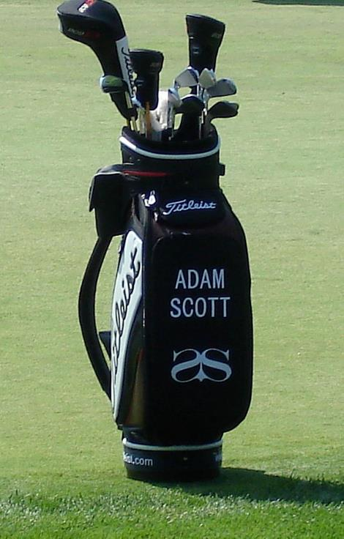
Have you heard of Golf Bag Leadership?
Invest a few minutes right now and assess your current leadership “style.” You may at times be democratic or a delegator, a pace-setter, or any other number of styles, but more than likely you have a “go-to” style. The recommendation is to move away from a singular style or “golf club” during this time of crisis and instead think of your leadership as a “golf bag” carrying different leadership styles for various situations.
In the great game of golf, you want to select the right club once you have assessed the lay of the ball, the distance, and various other factors. The same should be true for our leadership styles. For most of us, the lay of the ball has shifted — our environment has changed dramatically in the midst of this crisis. You need to now feel empowered to “select a different club” or style than you normally would because everything happening is unprecedented. That might mean you are a lot more directive and commanding in your leadership style for the sake of saving the company. Communicate this shift in your leadership style to your people. It certainly will not be like this forever, but this is how we will survive today. As a leader, you have the freedom to change that style in order to combat the present circumstances.
SOURCE: LEADERSHIP DURING A CRISIS: Leadership, Engagement and Culture — ENNIS Legacy Partners (ennislp.com)

Slide 31
Crisis Leadership
Crisis is inevitable, failure doesn't have to be
Paul Robertson, PWC at TEDxBristol
Click play ……

Slide 32
03
Product Sales Crisis:
When your product or company experiences a sudden drop in demand leading to loss

Slide 33
Product Sales Crisis
According to Benny Reich, Strategic Product Leader, when we work on a product we have our strategy, our roadmap, and our plan. The team can execute it and we adapt it in an agile way as we go. Sometimes the plan can face a crisis. It can be a good crisis such as a big potential customer that may require some new features to be developed very fast to win them or a bad crisis such as a critical problem in our production system that might cause it to stop working if we do not handle it properly in time.
In such situations, several things might happen. If the process works as it should, the right people will jump on the crisis or the opportunity and will do the necessary things to work on it and solve what is needed to be solved within time.
In a crisis, sellers face a variety of challenges such as:
A product that may no longer be relevant or urgent in the new reality
Lost access to customers
Diminished chances for finding new prospects

Slide 34
Actions to take in a product crisis
That is the easy part, even though it sometimes seems like magic. Depending on the type of crisis, this is the time in which a good product lead or sales manager can make a difference. Their job should be to calm things, put them in proportion and make sure that while the right team solves the crisis, keeping collateral damage to a minimum.
PRODUCT CRISIS
Analyze the product crisis and make sure it gets the right resources. No less. No more.
Control the flow of information. Make sure that the team working on the crisis has all the right data on the situation. Share timely updates with the rest of the team but make sure not interfere with the team working on the crisis. You have to protect this team.
Once things are in motion, make sure whoever is not needed for solving the crisis can continue to work. You may need to shift priorities, update the plan, but there is no point in paralyzing the team.
PRODUCT SALES CRISIS
In terms of a product sales crisis, in a sales drop, driven by panic, poor leadership, or a combination of both, many sellers fall prey to bad behaviours, which amplifies an already dire situation and damages their business prospects for the future.
In a crisis, fear and panic are pervasive - both within selling organisations and also within their customers’ organisations. Increasing pressure to close deals, without clear guidance on how to navigate a crisis situation, exacerbates fear and is more likely to trigger unproductive seller responses.

Slide 35
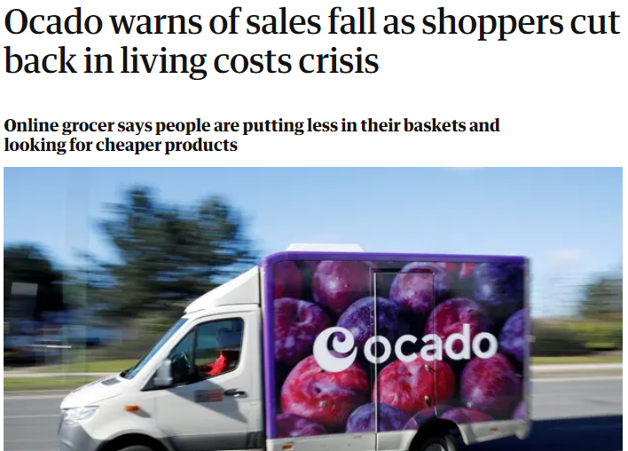
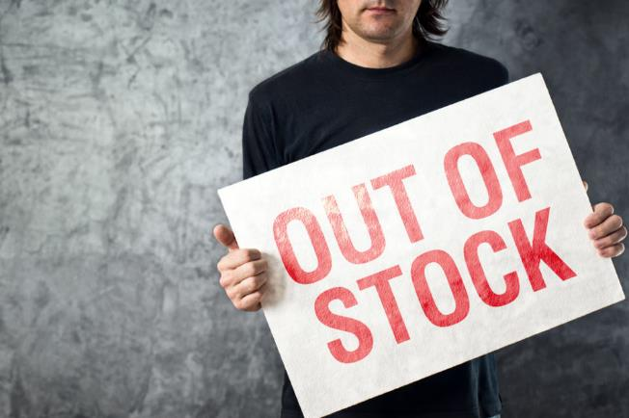
Innovating your Product Portfolio
SMEs should ask themselves two critical questions:
Do we have a product the world needs right now?
Or, can we rapidly adapt our product portfolio to provide goods that are urgently needed?
In pursuing this approach, companies can use their strengths to provide essential products, even if those goods are outside of their current product offering.
More practical advice can also be found in Product Planning in Times of Crisis.

Slide 36
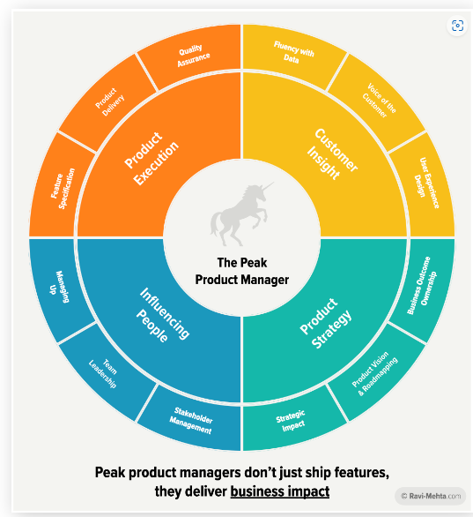
The function of Product Management
Product Managers are like the mortar in a brick wall. Like mortar, they must fluidly fill the gaps to make the product proposition and the whole team stronger.
The are four key areas of Product Management that are critical to driving business impact:
Product Execution (the ability to build exceptional products)
Customer Insight (the ability to understand and deliver on customer needs)
Product Strategy (the ability to drive business impact via product innovation), and
Influencing People (the ability to rally people around the team’s work).
Ravi Mehta is doing impressive work in this area ..
How To Become a Peak Product Manager (ravi-mehta.com)

Slide 37
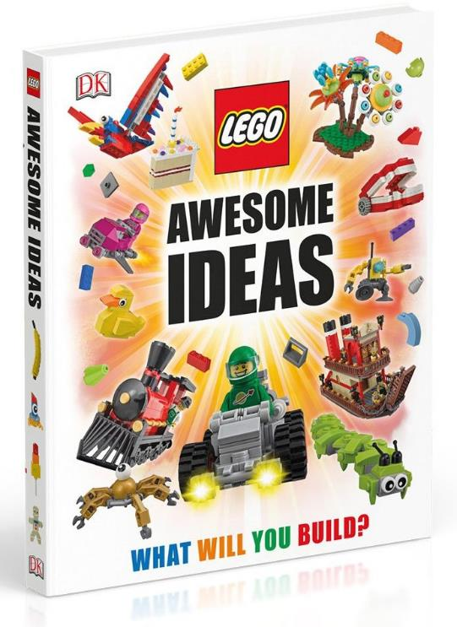
CASE STUDY – LEGO - the challenge
Most of us are familiar with :ego System A/S, better known as LEGO, the Danish toy company. Its best-known product is building blocks, but it also has its own series (Bionicle, Ninjago); a line of preschool products (Lego Duplo) and a line of robotics toys (Lego Mindstorms) among other assets. It also lends its brand to the Legoland theme park chain.
The company wanted to grow, but it innovated in the wrong direction. LEGO introduced new products that focused on rare pieces and extravagant sets that drove up costs. They invested too much in a strategy that didn't work.
In this period of crisis, they had occasional successes with characters and universes such as Star Wars or Harry Potter, but they were temporary successes, when the movie went out of the headlines, sales suffered and they did not manage to compensate for the losses

Slide 38
CASE STUDY – LEGO – the intervention
Jørgen Vig Knudstorp joined LEGO in 2001 after working as a McKinsey & Company consultant and university researcher at Aarhus University. Under Knudstorp's tenure, LEGO Group's yearly income went from a loss to drawing a notable profit and a 600% increase in turnover from 6.3 billion to 37.9 billion in 2016. In December 2016, it was announced that Knudstorp would step down as CEO of LEGO, and instead take the position of chairman of the group.
He led a company refocus on reducing costs and improved the product mix. Themed sets that did not work were no longer sold. Key lines were revived: City, Technic and even Duplo, which had been discontinued. Aware that children were moving away from traditional toys and did not want to play with just plastic parts, he started using digital components to complement the experience. It turned to the Internet. LEGO created its own social network, discussion forums and mini-games on its website. An online community was designed so that users could share their creations.. Not all digital initiatives worked, but the company learned that it had to be very agile.
Today, Lego is considered the most profitable game manufacturer in the world and exceeds Mattel in turnover.

Slide 39
CASE STUDY – LEGO – the intervention
Jørgen Vig Knudstorp joined LEGO in 2001 after working as a McKinsey & Company consultant and university researcher at Aarhus University. He led a company refocus on reducing costs and improved the product mix. Themed sets that did not work were no longer sold. Key lines were revived: City, Technic and even Duplo, which had been discontinued.
Aware that children were moving away from traditional toys and did not want to play with just plastic parts, he started using digital components to complement the experience. It turned to the Internet. LEGO created its own social network, discussion forums and mini-games on its website. An online community was designed so that users could share their creations.. Not all digital initiatives worked, but the company learned that it had to be very agile.

Slide 40
CASE STUDY – LEGO – outcome
Under Knudstorp's tenure, LEGO Group's yearly income went from a loss to drawing a notable profit and a 600% increase in turnover from 6.3 billion to 37.9 billion in 2016. In December 2016, it was announced that Knudstorp would step down as CEO of LEGO, and instead take the position of chairman of the group.
Today, Lego is considered the most profitable game manufacturer in the world and exceeds Mattel in turnover. Lego’s revival has been called the greatest turnaround in corporate history. A book devoted to the subject, David Robertson’s Brick by Brick: How Lego Rewrote the Rules of Innovation, has become a set business text. Sony, Adidas and Boeing are said to refer to it. Google now uses Lego bricks to help its employees innovate.
READ MORE ABOUT LEGO’S TURNAROUND
LEGO is an amazing business turnaround story - Mani Masood

Slide 41
04
Customer Base, Dependency, and Relationships

Slide 42
Developing a Loyal Customer Base to withstand a crisis
A customer base is a targeted demographic or group of people with similar interests, which make their interest in a product or service more likely.
Constantly know their needs and cater to them with proactive new products and ideas to meet demand.
Offer discounts, incentives and subscriptions for return customers to keep them loyal
Superior customer care -let customers know that you actually care.
Source: diriya.lk (2022),
https://diriya.lk/developing-a-loyal-customer-base-during-the-current-crisis/

Slide 43
Six things you can do right now to build and maintain strong customer relationships:
01
(Re)focus on your forever promise.
Step back from your products and services and just think about the business environment your customer faces and how you can help them to succeed in meeting their objectives.
Determine who your best customers/target markets are and, more importantly, who they aren’t.
Be very specific about who you serve and why.
Expand “customer success” beyond your support teams.
Everyone in the business should be working together to make sure that customer needs are met and communications with customers are clear.
02
03

Slide 44
Six things you can do right now to build and maintain strong customer relationships during this crisis:
04
Include members of your frontline customer team in diagnosing relationship weaknesses
These individuals have a much clearer line of sight to the customers and the problems they face.
Find a way to have the customer “in all rooms” where decisions are being made, both in structured and unstructured meetings.
You want to feel as if your customers are watching you, eager to see how you are leading, and hoping you’re worthy of their trust. Amazon leaves an “empty seat for the customer” in meetings to ensure customer-aware decisions.
Identify the biggest challenges that are preventing your best customers from achieving that goal you promised to help them with.
And determine if this crisis requires a different, short-term approach to take better care of current and future members, right now.
05
06

Slide 45
05
Understanding the Role and Function of Data Systems and Tools of Internal and External Analysis

Slide 46
Information Sources in the Company: HR
Sick Leave
Did the percentage of sick leaves change over time?
Time until positions can be re-staffed
Is it more difficult to re-staff positions or do you need to pay more to convince candidates?
Agony Box
Do your employees have the chance to mention important topics anonymously?
A large number of indicators for crises in early phases can be determined from the personnel department. Employees usually have a very sensitive feeling for the company - even if they do not articulate it directly. With relatively little effort you can generate important information about the state of the company – especially when you review them over time.
Staff Interviews
Do you conduct regular Staff Interviews? Are they open to for constructive feedback?
Initiative Applications
Do less people send you initiative Applications?
Online Ratings as Employer
Do you track online platforms for ratings of Employers?
Employee surveys
What are the topics your employees rate as important?
Feedback Culture
Do you have a constructive, open company culture? Did Mood and Motivation change?

Slide 47
Information Sources in the Company: R&D
The R&D Department or the person responsible for developing the innovations that are essential for the sustainable success of the company. Therefore, it is especially important to monitor if there are signs of deterioration in performance. Some ways you can monitor R&D performance and reveal any first warning signs are….
# Time needed to prepare Innovations / Patent Claims
# Number of Engineers / Staff with PhD Degrees
€ Invested in R&D per € of Sales
€ Cost savings achieved due to R&D / Innovations
# New Products per R&D Staff
# First to market products
# Number of Product Development Products in Pipeline

Slide 48
Information Sources in the Company: Procurement
Compliance Rate
Understand if suppliers fulfill your requirements
Number of Suppliers
Track your level of dependency towards your suppliers
Purchase order cycle time
Know who to address your urgent orders to
Supplier Availability
Measure suppliers’ capacity to respond to demand
In many business models, purchasing represents a central cost block and the supply chain is a key success factor. Nevertheless, surprisingly few companies have a transparent overview of the scope of data that you should be monitoring the purchasing area.
Supplier
Defect Rate
Evaluate your suppliers’ individual quality
Cost of
Purchase order
Control the internal costs incurred by each purchase
Procurement Cost Reduction
Streamline the tangible costs savings

Slide 49
Information Sources in the Company: Operations
Production Volume
Track the quantities that you can produce
Production Downtime
Analyse and optimise your maintenance
An operational KPI is a quantifiable value expressing the business performance in a shorter time-frame level. They are used in different industries to track organisational processes, improve efficiency and help businesses to understand and reflect on the outcomes. Choosing the right KPIs is of course dependant on your business model. Here are some examples of indicators from manufacturing:
Production Costs
Monitor the costs implied in the production
Rate of Return
Measure how many items are sent back
Right first time
Understand the performance of your production process
Asset Turnover
Acknowledge your assets in relation to your revenue
Unit Costs
Track and optimise your unit costs over time

Slide 50
Information Sources in the Company: Outbound Logistics
Shipping Time
Spot potential issues in your order fulfilment process
Order Accuracy
Monitor the degree of incidents
Delivery Time
Track your average delivery time in detail
A logistics KPI or metric is a performance measurement that is used by logistics managers to track, visualise and optimise all relevant logistic processes in an efficient way.
Among others, these measurements refer to transportation, warehouse and supply chain aspects.
Transportation Costs
Analyse all costs from the order placement to delivery
Warehousing Costs
Optimise the expenses of your warehouse
Number of Shipments
Understand how many orders are shipped
Inventory Accuracy
Avoid problems because of inaccurate inventory

Slide 51
Information Sources in the Company: Marketing and Sales
Customer Lifetime Value
Costs per Acquisition
Are your customer acquisition costs viable?
Here we will give you a short overview about Customer related metrics that are worth to be evaluated.
Cost per Lead
How much should you spend per lead?
Sales Targets
Is your sales growing and reaching its targets?
Return on Marketing Investments
How efficiently are you spending your marketing budget?
Customer Lifetime Value
Are new customers profitable in the long-run?

Slide 52
Information Sources in the Company: Service
Customer Satisfaction
Customer satisfaction is everything. Measuring customer satisfaction is difficult
If the quality of customer service is not measured, how can the success of actions be judged?
If a company is seriously interested in improving their customer service, these are the KPIs to be reviewed.
Net Promoter Score
The NPS measures the probability with which your customers recommend you to another person.
First Response Time
Speaed is a decisive factor for customer satisfaction
Customer Churn Rate
Customer churn helps you see trends in product satisfaction (or dissatisfaction)
ServeQual
Quality of service + Customer satisfaction

Slide 53
The Absolute Minimum that should be Monitored
By defining relevant observation areas and selecting suitable early detection indicators, changes in the market and in the company can be systematically identified and monitored. By significantly changing an indicator, a signal is given to discuss and, if necessary, initiate measures. There is a number of minimum areas that should be constantly observed.

Slide 54
The Absolute Minimum that should Be Monitored
08 Capital Market
Interest, exchange rates – See Module 2 to see what this is important
07 Financials
Short-term liquidity planning / 3 Year Planning / 1 Year Forecast / Accounts Receivable / Accounts Payable
06 Employees
Fluctuation / Sick Leaves / Age Structure
05 Production
Age Structure of Machines / Investment Backlog / Capacity Utilization / Energy Consumption / Scrap / Cost of poor Quality / Maintenance Costs
01 Cyclical/structural developments
Orders received / Business climate /
Consumer sentiment
02 Technology / R&D
New process + technologies / Consumer behaviour / Number of current development projects / Number of own patents/ Licenses granted / Research and development costs
03 Sales
Number of enquiries per Period / Development of orders in your main industry (which will later affect your orders) / Revenues / Prices / Price and Product Strategy of your competitors / Lost Orders
04 Procurement
Raw Material prices / Stocks / Quality and Adherence to delivery dates of suppliers
08
07
01
06
02
05
03
04

Slide 55
06
Earnings (Bottom Line or a Company’s Profits) and Liquidity Crisis

Slide 56
Liquidity Crisis
A liquidity crisis is a financial situation characterised by a lack of cash or easily-convertible-to-cash assets on hand across many businesses or financial institutions simultaneously.

Slide 57
Overcoming a Liquidity Crisis
To overcome the liquidity crisis
the liquidity gap must be closed externally, either by injecting liquid funds or through standstill agreements with creditors.
The recovery of sufficient liquid reserves must be mobilized.
Any remaining creditworthiness can help the company to improve its rating and provide sufficient guarantees.

Slide 58
Overcoming a Liquidity Crisis
10
01
Other
Factoring
09
02
Nominal vs.
Capital Increase
Inventory
In addition to additional loans or shareholder contributions, the following possibilities are worth mentioning:
Receivables Management
08
Mezzanine Capital
03
07
Capital Reserve
04
Outsourcing
06
05
Sale and Lease Back
Investors

Slide 59
Let’s look at these tactics in more detail …
01
Factoring
Selling of receivables to reduce the time to receipt of money and the default risks. More Factoring (finance) - Wikipedia
Inventory Optimization of inventory management / stock reduction
Receivables Management Reduction of payment terms/consequent management of receivables More Receivable Management: Meaning, Objectives, Importance | Tally Solutions
Outsourcing Outsourcing of non-core functions to reduce fixed costs More Outsourcing - Learn About the Advantages and Disadvantages (corporatefinanceinstitute.com)
Sale and Lease Back More
Sale of fixed assets and lease back. Sale and leaseback definition — AccountingTools
Investors
Equity through external investors - Private Equity
02
03
04
05
06

Slide 60
Overcoming a Liquidity Crisis
07
Capital Reserve More Capital Reserve (Meaning) | Examples of Capital Reserve (wallstreetmojo.com)
Payment into the capital reserves vs. capital increase
Mezzanine capital
Mezzanine capital injection (financial resources with an intermediate position between equity and debt) More Mezzanine Capital: The Basics - AB Capital (trustabcapital.com)
Nominal vs. effective capital increase
Nominal capital increase = conversion of free reserves into liable capital (share capital and nominal capital)
Effective capital increase = capital increase against contributions (cash or non-cash), authorized or conditional capital increase More Interest Rates Explained: Nominal, Real, Effective (investopedia.com)
Other mechanisms
Shareholder loan Atypical/typical silent partnership
Profit participation certificate Option and convertible bonds
Subordinated loan (junior debt or subordinated debt)
08
09
10

Slide 61
Overcoming a Liquidity Crisis
It is extremely difficult to acquire outside capital in advanced crisis phases. Banks are often no longer able to become active due to risk regulations. In principle, financiers in a crisis demand plausible restructuring concepts, sufficient securities and higher interest rates.
Shareholder Loan (Equity)
Loans from customers advance payments
01
New loans from financiers (seasonal loans / bridging loans)
07
02
DEBT CAPITAL
06
03
Deferment and waiver by third parties
Leasing
05
04
Factoring
Supplier Credit

Slide 62
Given this is such an important topic, we direct you to our dedicated Module on the area ….
MODULE 5 - UNDERSTANDING FINANCIAL AND LIQUIDITY RATIOS & INSOLVENCY AS A RESTRUCTURING APPROACH

Slide 63
07
Operational Crisis

Slide 64
Operational resilience, crisis and continuity
Operational Risk and Crisis
“Operational Risks” is a risk that includes errors because of the system, human intervention, incorrect data, or because of other technical problems.
Operational risk is inevitable in any process or transaction but pperational crises create dangers for stakeholders, such as risk of injury to customers, or exposure to hazardous chemicals for employees or community members.
Therefore, stakeholder safety should be the primary concern during an operational crisis along with the need to maintain or to restore operations.
Operational resilience is the embedding of capabilities, processes, behaviours and systems which allows an organisation to continue to carry out its mission, in the face of disruption regardless of its source.
SMEs are investing more into this protective discipline in order to anticipate, protect and plan for recovery at all times. PWC have developed a Guide to Operational Resilience.
DOWNLOAD operational-resilience-guide.pdf (pwc.co.uk)

Slide 65
The Top 5 Operational Risks
Source: Operational Risks (wallstreetmojo.com)
Defining Operational
Risk in SMEs
1 – Human Error
This error is the most common and significant risk to the SME and the individual. It may also relate to a skill issue of the individual/ processor. This type of error evolves when incorrect input is because of human error.
The reasons for incorrect input may be multiple, including incomplete information, incomplete understanding, insufficient knowledge, inconsistent processing, genuine input error, or more. However, processing such an error may affect the output seriously and may also lead to a loss.

Slide 66
The Top 5 Operational Risks
Defining Operational
Risk in SMEs
1 – Human Error – example
ABC Corp deals in providing financial services to its clients. They process their client’s credit ratings based on various parameters. In one case, the processor made an input error, wherein he inputted €1,000,000 instead of €100,000. As a result, the client’s credit rating changed from B to AA.
This gave an incorrect picture of the client’s creditworthiness
in markets and resulted in an overestimation of debt repayment capacity. This is one of the operational risks that ABC Corp faces, and if repeated, may lead to disastrous results.

Slide 67
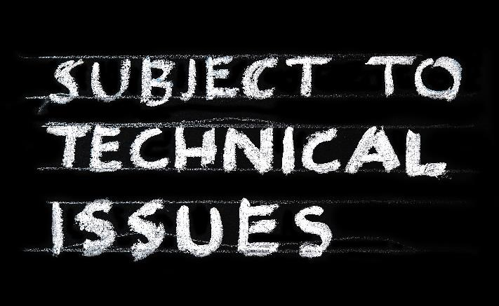
The Top 5 Operational Risks
Defining Operational
Risk in SMEs
Technical Error
This includes system glitches and issues like a slowdown, connectivity, system crashes, incorrect calculation and the like. Sometimes, the output received may be off from the expected result, but because of unknown technical defects, it may be challenging to catch.

Slide 68
The Top 5 Operational Risks
Defining Operational
Risk in SMEs
Gap in Flow
Sometimes, information is missing from the source itself because of data lag or restrictions. In such cases, the output gets affected. The required production varies from that desired and may put the process at risk.

Slide 69
The Top 5 Operational Risks
Defining Operational
Risk in SMEs
Uncontrollable Events
Typically these include effects from an external environment (see Module 2) like political scenarios, weather changes, pandemics, outdated technology, etc., which affect the internal performance and put the output at risk.

Slide 70
The Top 5 Operational Risks
Defining Operational
Risk in SMEs
Intentional Fraud
There have been cases where intentional conflict has arisen. Most organisations have a clause in their policies that the employees have to abide by fighting against conflict of interests and fraudulent practices, failing which they meet with extreme consequences. However, if such an event occurs, the SME has to bear monetary and defame losses, which are sometimes irrecoverable.

Slide 71
CASE STUDY – Flame GmbH, Germany – the challenge
Flame GmbH converts vehicles for fire brigades in particular. The vehicles are procured from the manufacturer and converted according to the customer's specifications and the applicable standards and laws. The company in northern Germany has grown continuously in recent years. Among other things, they took over the Thrower company as part of a succession, which also converts vehicles for the military and other applications at a second location. The company now has a total of about 30 employees.
With the takeover of the Thrower company, additional problems arose. Different costing and project management systems and different corporate cultures have meant that planned synergies could not be achieved, but the opposite has occurred. Processes no longer functioned, and problems arose in production.

Slide 72
CASE STUDY – Flame GmbH, Germany – the challenge
In addition, in order to cover the increased fixed costs,
Orders were accepted that overstretched the company.
Materials were used with which the production team had no experience
international orders were accepted for which they were not familiar with the standards and specifications.
As a result, the project calculations were wrong and considerably more man-days had to be invested in the orders than planned. This put the company in acute payment difficulties.

Slide 73
CASE STUDY – Flame GmbH – the intervention
Due to the acute payment difficulties, the company sought advice from an advisor experienced in insolvency matters. Together they analyzed the situation and determined that the company was not yet insolvent, but there was a threat of insolvency, i.e., in Germany it has the right to file for insolvency, but not the obligation.
At the same time, the company's business model and all corporate processes were systematically analysed. As a result, a contingency plan was developed, and a comprehensive strategic reorientation was initiated in parallel.
Immediate intervention measures:
Immediate adaptation of the calculation scheme for quotations: The calculation scheme has been standardised and revised. All offers currently in progress were recalculated with the new calculation scheme - and some offers that did not promise a sufficient margin were withdrawn.

Slide 74
CASE STUDY – Flame GmbH – the intervention
- Sale and Lease Back: To ease the liquidity situation, machines were sold to a leasing company, from which the machines were then leased for a fixed period of time (Attention: this is typically an expensive form of financing and should only be used in emergencies)
Factoring: The existing orders and the associated receivables were sold to a factoring company, which paid out part of the receivables directly
Negotiating with clients: Clients were approached, and it was partly possible to obtain additional deposits from them

Slide 75
CASE STUDY – Flame GmbH – the intervention
Strategic intervention measures:
- Concentration on the core business: In the analysis it has been found out that the original core business (mainly the conversion of fire fighting vehicles mainly for the German market) continued to be highly profitable, while the international projects as well as the projects that produced vehicles for other applications were the cause of the problems. The medium-term strategy was therefore to concentrate on the core business. To this end, the following measures were initiated:
- Sale of the second site to a specialist builder of military vehicles: A buyer was sought for the newly acquired site, who took over the existing orders as well as the employees of this site.
- Closure of international sales: As the international projects and the associated requirements with regard to standards and materials led to considerable production problems, international sales were closed.

Slide 76
CASE STUDY – Flame GmbH – outcome
The desired growth of the company has led to the company back to success. Based on deep analysis, it determined which areas were profitable and appropriate measures were initiated.
However, firstly ad-hoc measures had to be implemented to avoid the acute risk of insolvency. For this purpose, financial losses had to be accepted (high costs due to sale-and-lease-back, losses due to the cheaper sale of the second location, which was taken over at a much higher price). This created the necessary time and financial leeway to be able to initiate the necessary strategic reorganization.
The company is now operating profitably again in its original segment.

Slide 77
08
Technology Deficits – Lack of Skills and Resources

Slide 78
Technology Deficits
How many of these challenges resonate with your business?
NSBA survey reveals the challenges as :-
Costs of needed upgrades: 44%
Security issues: 42%
Time it takes to fix problems: 37%
Cost of maintaining technology: 36%
Breaks in service: 30%
Lack of expertise: 26%
Response time from external support company: 18%
Is managing your IT getting easier or harder?
In Module 2, we put the spotlight on technology crises from external factors such as cybercrime.
As a very real internal risk, technology deficits through a lack of skills and resources can lead to serious consequences.
According to the OECD, some SMEs face an internal skills gap that prevents managers and workers from identifying the digital technologies they need and adapting business models and processes.

Slide 79
Inhouse or Outsource?
Small businesses have a lot of competition when it comes to hiring employees with an adequate skill set required for solving IT issues. Larger companies have the advantage in that they can offer higher salaries and better benefits, so SMEs may have to outsource their IT staff to reduce costs.
While nearly half of small businesses outsource most or all of their technology management and support, this is not necessarily an effective way to manage IT issues. Outsourcing can be inefficient, and problems can arise when there is no one qualified in-house performing the function as the firm’s IT expert.

Slide 80
Technology enables SMEs to automate tasks, give customers an easy way of making a sale, conduct research, collaborate on tasks, communicate with people, and much more.
But be aware of the 4 potential risks that may arise.
SOURCE 4 Common Tech Failures For SMEs In 2022 ⋆ Isa Lillo
4 Common Tech Failures for SMEs
1) Not taking tech security seriously
When it comes to the technology mistakes that companies make, cyber security is the evident place to begin. A lot of businesses today have the “it won’t happen to me” attitude. However, it does not matter how big or small your company is, you are a target. You need to make sure you have a carefully thought-out plan when it comes to protecting your business. Plus, this is something that you need to continually update, as the threat landscape is changing all of the time.
2. Aging technology and lack of investment
Planning and configuring your ICT hardware and software so it is efficiently responding to your business need.

Slide 81
4 Common Tech Failures for SMEs
3) Using social media in the wrong way
It is also important to make sure your business is using social media effectively. Social media enables you to connect with customers and potential customers. Netiquette is essential - Etiquette in technology – Wikipedia
READ 10 Social Media Fails to Avoid in 2021 (hubspot.com)
4) Not scheduling maintenance on a regular basis
Avoid as much downtime as possible by investing in IT operations and maintenance, or IT O&M. This is the process of monitoring, upgrading, and maintaining an organization’s applications and IT infrastructure on a continuous basis. IT O&M is critical in keeping IT systems and networks secure and operating effectively and efficiently.
READ IT Maintenance: Taking the right approach for maintaining your IT Systems - Businesstechweekly.com

Slide 82
09
Organisational / Personnel Crisis

Slide 83
Personnel Crisis
A personnel crisis happens when somebody from the SME becomes involved in illegal or unethical behaviour, impacting the company's public reputation. The issue might be related to the employee's conduct at work or in their private life. The way the company manages the situation is extremely important, as handling it effectively can help them maintain a more positive public image.
For example, a company may get bad press because of a workplace conflict or an insensitive comment by a senior executive.
When an organisation faces a personnel crisis, it is important to present a balanced plan that addresses the issue directly.
With the help of relevant stakeholders, the company should determine the appropriate disciplinary measures to take against the employee who caused it, both to preserve their legal rights and protect the reputation of the business.
Sources: Indeed, 2021: https://www.indeed.com/career-advice/career-development/types-of-crises
HubSpot, 2022: https://blog.hubspot.com/service/types-of-crisis

Slide 84
From a personnel perspective
the three types of organisational crises are:
Crisis of Deception:
This type of crisis occurs when a company knowingly lies about public-facing product information or tampers with public-facing data.
Crisis of Management Misconduct:
This type of crisis is a result of management willingly and knowingly engaging in illegal activities.
Crisis of Skewed Management Values:
This type of crisis results when senior leadership emphasises short-term financial gains over social responsibility and neglects the interests of stakeholders such as customers and employees.
Sources: Indeed, 2021:
https://www.indeed.com/career-advice/career-development/types-of-crises
HubSpot, 2022: https://blog.hubspot.com/service/types-of-crisis

Slide 85
Changing company culture is the best way to address organisational crises because these problems are typically caused by employees who neglect customer needs.
Embracing an organisational culture that's dedicated to customer success can reduce the chances of encountering an internal crisis.
Additionally, companies should proceed to hire employees who are closely aligned with their values.

Slide 86
Examples of Organisational Crises
In late 2020, Google faced allegations of spying on employees and discouraging unionised organisations. The firm “illegally surveilled” employees’ discussions when they aired their workplace grievances.
To meet sales quotas, Wells Fargo’s employees illegally opened millions of fake customer accounts without the customers’ consent.
Employees falsified signatures and created fake records that resulted in billions of dollars in revenue. In 2020, Wells Fargo paid a settlement of $3 billion to cover the corporate penalties incurred.
Google made a public statement to
The Verge, saying,
“We’re proud of [our] culture and are committed to defending it against attempts by individuals to deliberately undermine it. [...] Such actions are a serious violation of our policies and an unacceptable breach of a trusted responsibility, and we will be defending our position.”

Slide 87
3 MAJOR COMPONENTS WHEN UNEXPECTED PERSONNEL SITUATIONS ARISE
Transparency: The first critical component of establishing a nimble organization that responds well to diversity is transparency. While some information needs to be kept confidential, such as financial or human resources information, process information—who does what and how—does not. Everyone one on your team should know the expertise and workload of their co-workers.
Not only does this create a more transparent and appreciated work environment, it prevents stone-throwing and provides everyone a clear understanding of their value and role. This way, when someone does leave unexpectedly, other employees already are familiar with the workload and have the opportunity to step up and negate the short-term pain.
2) Cross Training: Not only should everyone be fully aware of what their co-workers do, they also should be somewhat cross-trained. While being a product specialist or a subject matter expert is great for the individual, it's not as valuable to the enterprise as a whole. Managers should make sure all their employees have backup and can do each other’s job at a certain level, even if it’s not their primary responsibility. This protects the company from possible skill gaps and it helps employees grow by giving them more expertise and career options.
SOURCE How to Avoid a Personnel Crisis When a Personnel Crisis Hits – Channel Futures

Slide 88
3 MAJOR COMPONENTS WHEN UNEXPECTED PERSONNEL SITUATIONS ARISE
3) Trust:
The final component is trust. As an owner/ manager, you need the trust and support of your personnel and leaders to execute projects when resources run unexpectedly low. You need to know you can make decisions on the fly for the short term while the longer-term strategy is being developed.
As a manager, you need to be able to trust your employees to step up when diversity hits and not micromanage them or expect them to do it the same exact way as the person who is no longer available. Without trust, both from the board room down to the operations level, a personnel crisis will become just that—a crisis
SOURCE How to Avoid a Personnel Crisis When a Personnel Crisis Hits – Channel Futures

Slide 89
Next Module 4..
LEADERSHIP CULTURE, STAKEHOLDER MANAGEMENT AND COMMUNICATIONS
www.facebook.com/SECure.ErasmusProject
www.twitter.com/SECure_Project
www.linkedin.com/company/secure-project/
www.smecrisistoolkit.eu

