Slide 1
SECure CURRICULUM AND VET .TRAINING PACKAGE
MODULE 2
A Crisis That Comes From External Unavoidable Factors

Slide 2
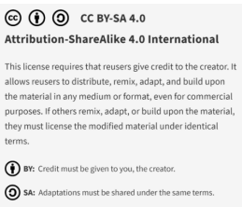
Why is our SECure CURRICULUM and VET TRAINING PACKAGE special ?
The SECure CURRICULUM AND VET TRAINING PACKAGE is the first holistic VET approach to address early crisis detection and resolution based on a framework specifically developed for SMEs. It does this by combining a curricula-based approach, which can be adopted in teaching and training by VET, with a modular approach, which is particularly useful for consultants and for use directly by SMEs and founders.
"The European Commission support for the production of this publication does not constitute an endorsement of the contents which reflects the views only of the authors, and the Commission cannot be held responsible for any use which may be made of the information contained therein."

Slide 3
MODULE 01
THE FUNDAMENTALS
Based on the findings of the SECure International Early Warning System Learning Framework (IO1) , the SECure VET Package and learning model has been designed across six engaging training modules:-
What is a business crisis and what are early detection mechanisms?
Knowing when –an overview of the 3 phases on SME/business crisis - main stages, the pre-crisis, the management and response stage itself and the post-crisis
MODULE 02
A CRISIS THAT COMES FROM EXTERNAL UNAVOIDABLE FACTORS
You did not see this coming, it’s not usually something you’re prepared for, but once it happens, you wish you were, e.g. natural crisis, weakening economy and calamities, market environment e.g., supply chains , technology related issues .
MODULE 03
A CRISIS THAT COMES FROM INTERNAL FACTORS
Management skills and culture,
Product sales crisis, Customer base, dependency, relationships.
Data systems and tools of internal and external analysis within the business
Earnings and liquidity crisis
Operational crisis
Technology deficits – lack of skills and resources
Organisational/personnel crisis
MODULE 04
LEADERSHIP CULTURE, STAKEHOLDER MANAGEMENT AND COMMUNICATIONS
MODULE 05
UNDERSTANDING FINANCIAL AND LIQUIDITY RATIOS & INSOLVENCY AS A RESTRUCTURING APPROACH
MODULE 06
EARLY WARNING SYSTEMS
As an SME with limited resources, how can you implement early warning systems that enable you to detect crises at an early stage before they take on dimensions that threaten the company's existence.

Slide 4
01
What are the types of crisis that can arise from external factors?
A Crisis That Comes From External Unavoidable Factors
MODULE 02
02
Natural crisis
03
Financial crisis
04
The uncertainties that arise from the market environment
Success in business frequently gets attributed to the proactive decisions made at the management level, but that’s not the whole story. Just as often, success or failure is determined by how business owners and managers handle situations that are out of their control. How businesses deal with external crises can have a powerful impact on their survival.
05
Technological crisis
06
Fuel crisis
07
Crisis Support Approaches

Slide 5
01
What are the types of crisis that arise from external factors?

Slide 6
What are external factors ?
External factors are elements that exist outside of a company's internal environment that can affect a company's operations. These outside forces can help SMEs or present challenges to its current processes. SMEs must keep track of external environment factors so they can recognize and resolve the issues the factors cause and make appropriate changes.
Why are external environment factors important?
External environment factors are important because they can cause direct and indirect effects on business operations, personnel and revenue. The external environment of an SME changes constantly in ways beyond the company's control, but owners and managers can track these changes and minimize their consequences. Choosing to monitor the dynamic nature of external environment factors allows businesses to protect themselves against predictable events and mitigate the effects of unexpected changes.
In this module, we will focus on 4 types of crisis from external sources…

Slide 7
4 types of crisis from external sources…
Natural crisis – increasingly common due to climate change e.g., extreme weather incidents, biohazards e.g. COVID-19
Financial crisis - Weakening economy and calamities
The uncertainties that arise from the market environment e.g., supply chains
Technological crisis - Technology related issues such as power outage or cyber attacks

Slide 8
02
Natural Crisis

Slide 9
Natural Crisis
Natural crisis are typically not in the hands of anyone. A natural crisis takes place because of the occurrence of natural phenomena such as earthquake, volcano, floods, storms or any other act of nature. Damages caused by such occurrences are classified as a natural crisis. Natural disasters are well-known for the huge economic damage they can cause, especially when striking high-density industrial areas (tourism included).
EXAMPLES- WEATHER: The summer of 2013 saw major floods hit many countries in central Europe, and particularly in Germany. In hydrological terms, the June 2013 flood was the most severe flood in Germany since the 1950s. While they may be rare, can make a significant impact on businesses.
If an SME is located in an area that's exposed to extreme weather, there needs to be an emergency response prepared in the unfortunate event that the company is affected. Prepare a contingency plan for business operations should premises become unavailable and provide training to employees for what to do and not to do under such circumstances.

Slide 10
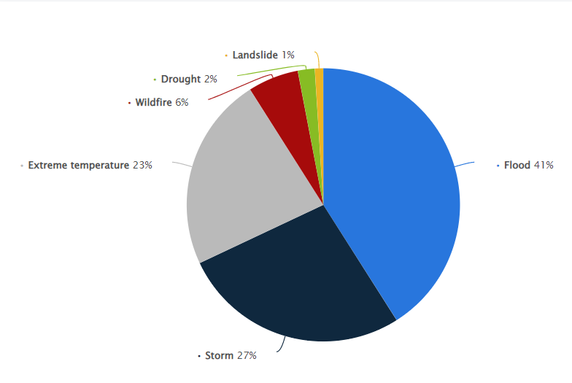
Natural Crisis – what it looks like in Europe…
Distribution of weather-related disaster incidents in Europe between 2001 and 2020, by type
Most common natural disasters Europe 2020 | Statista

Slide 11
Examples of a Natural Crisis
COVID-19: The coronavirus disease (COVID-19) pandemic is described as humanity’s worst crisis since World War II. The social, political, and financial consequences of this pandemic will remain for years and decades. According to the International Federation of Red Cross and Red Crescent Societies, pandemics are classified as a natural hazard. Disaster risk has a relationship with the type of disaster, vulnerability, and exposure or as a formula (risk = disaster*vulnerability*exposure).
While it took the world by surprise, It impacted not only businesses, but all of our societies. Many businesses swiftly built remote work and/or health protocols into their operating model to keep employees and customers as safe as possible. Governments across Europe brought in measures from financial aid to tax relief to help small businesses weather the pandemic. Bu, ,it came at a cost. The economic downturn caused by the pandemic has taken a painful toll on small businesses. For example, scores of retail businesses have permanently closed since the Great Lockdown in the spring of 2020.

Slide 12
SPOTLIGHT - How Covid-19 Changed Retail — Probably Forever
Bazaarvoice is a leading provider of product reviews and user-generated content (UGC) solutions.
As a key driver of transformation in retail over the last decade, e-commerce was already growing rapidly. Then the Covid-19 pandemic happened, which aggressively fueled company digitalization and the flight to e-commerce and triggered major shifts in consumer shopping behaviours— changes that are here to stay.
Bazaarvoice saw a massive increase in demand for their services. With more and more consumers online, brands and retailers that didn’t already prioritize e-commerce before the pandemic had to rush to do so.
According to data from IBM, the pandemic accelerated the shift to e-commerce by about five years. Two years ago, online purchases represented just under 14% of all retail sales. In 2021 that figure was just under 20%.
READ MORE Covid-19 prompts hundreds of businesses to move online (rte.ie) AND 5 ways Covid-19 could change retail forever (rte.ie)

Slide 13
SPOTLIGHT - How Covid-19 Changed Retail — Collaborate with Competitors
Dead Centre Brewing is a craft microbrewery and eatery on the banks of the River Shannon in Athlone. Having been awarded the title of Most Innovative Pub at the Irish Pub Awards, it was looking forward to a successful 2020 until, like thousands of other businesses, it was faced with sudden closure as the Covid-19 pandemic took hold.
"Craft breweries are feeling the pinch of Covid-19 really strongly," Liam Tutty, founder of Dead Centre Brewing. "The pubs, their main route to market, are now closed and as people are being encouraged to stay at home, buying at off licences is less of an option.“
Living up to its billing as an innovator, Dead Centre didn't waste time in
coming up with a way to sell its produce. Liam Tutty joined forces with
a group of fellow brewers and established an online store, beercloud.ie.
Now consumers can go onto the platform, order their favourite craft
brews and have it delivered to their homes within a day or two.

Slide 14
SPOTLIGHT - How Covid-19 Changed Retail — Probably Forever
Online is not necessarily killing traditional retail – it’s just making it live in a different way. Tweed brand Magee 1866 is a fifth-generation Irish family business with over 150 years’ experience in designing, weaving and tailoring luxurious fabrics and clothing in Donegal. It is among the vanguard of Irish retailers harnessing the potential of online shopping. Tweed has gone digital.
Magee 1866 operates three standalone stores –Donegal, Dublin and Kildare. But, online sales have now garnered 20 per cent of group revenues. Magee harvests a bounty of data from its customers, online and offline, and targets them with offers. It offers quick delivery using a high-tech order fulfilment system in partnership with ecommerce platforms. It has also installed iPads instore, so that its customers can browse the website while physically interacting with its products. “We had to embrace technology,”

Slide 15
SPOTLIGHT - How Covid-19 Changed Retail — Probably Forever
In Ireland, when COVID-19 challenged, the Department of Enterprise Trade and Employment (DETE) responded with a support intervention called the Online Retail Scheme .
This fund encourages the retail sector in Ireland to develop a more competitive online offer that will enable an increase in their customer base and build a more resilient business in the domestic and global marketplace both online and offline.

Slide 16
Natural disasters have a significant impact on the economy and the businesses in more ways than one. The impact of natural disasters on businesses can be seen through:
06
01
LOSS OF
CLIENTELE
SUPPLY CHAIN DISRUPTIONS
05
02
LOSS OF PERSONNEL
COMMUNICATION BARRIERS
LOSS OF EQUIPMENT
04
03
DAMAGED BUILDINGS
Let’s look at each of these factors in turn…..

Slide 17
Supply Chain Disruptions
01
Efficient and reliable supply chains are critical to the success of an SME. For example, the constant supply of milk is vital to the operations of a cheese-making factory. Unfortunately, natural disasters interfere with these supply chains because they affect roads, bridges, and transportation. More specifically, roads become impassable, bridges collapse. That means moving goods and services in affected areas is impossible. In the case cited above, the factory would stop its operations because it cannot produce cheese without receiving milk from its suppliers.
“Rarely does a week go past without something new,” says Tim Huxley, CEO of Mandarin Shipping. In 2021, heavy rainfall and flooding devastated parts of western Europe. Some of the most severe flooding happened in Germany and Belgium. Huxley explains “This really disrupts the supply chain because the railway links have all been broken.” Railways coming from the Czech Republic and Slovakia into the German ports of Rotterdam and Hamburg, were “seriously disrupted.”
READ MORE: The Impact of Natural Disasters on Economy and Supply Chain — and How to Prepare for the Worst (thomasnet.com)

Slide 18
Communication Barriers
02
Communication barriers occur when natural disasters destroy power stations, cell towers, and optical fibre lines, i.e. the loss of communication infrastructure. That means communicating with staff. customers and suppliers through calls, text messages, or social media is difficult or impossible.
Despite the increasing reliability and resiliency of modern telecommunications networks to physical damage, the risk associated with communications failures remains serious because of growing dependence upon these tools.
Business continuity plans are essential to manage through this crisis.

Slide 19
Damaged Buildings
03
Even temporarily closure of damaged buildings as a result of a natural disaster leads to loss of revenue and repair costs. Buildings can be submitted to extreme events such as natural disasters (hurricanes, tsunamis, flooding and earthquakes), accidents (explosions, vehicle collisions…) and actions such as terrorist attacks and sabotages. These events cause damage to their structure.
Clonakilty in Ireland "was like Venice" during floods in 2012 according to the local Mayor. All of the businesses and residential homes in the main thoroughfare of the town were affected by the flood waters.
Clonakilty "was like Venice" during floods · TheJournal.ie

Slide 20
Loss of Equipment
04
Businesses rely on different types of equipment depending on the products they offer and the scale of their operations. For example, tractors are an essential piece of equipment on any farm. Office equipment such as printers and photocopiers are critical to business operations as well.
Unfortunately, natural disasters affect them adversely. The cost of replacing damaged equipment becomes crippling for many businesses, especially if they do not have access to government loans or grants.

Slide 21
Loss of Personnel
05
Natural disasters can lead to the loss of personnel in multiple ways, and regrettably, people lose their lives during natural disasters. Globally, around 60,000 people die each year as a result of disasters such as droughts, floods, earthquakes and tsunamis, and a further 150 million people are impacted by these events. Source.
Examples of people lost in disasters in 2020:
January 24th: Earthquake in Turkey, 41 fatalities
October 30th, Earthquake in Turkey and Greece, 117 fatalities
Climate change is now also expected to worsen with damages caused by natural disasters due to rising temperatures and the inevitable increase in humidity. These climates are also favourable for the onset of severe weather events such as floods, storm surges, and wildfires. Climate change is likely going to increase damages caused by natural disasters and, therefore, the costs of recovery for society and our personnel availability will make an impact.

Slide 22
Loss of Clients
06
Natural disasters lead to the loss of clients as well because people move away from the affected area. It is worth noting that the ones who remain often spend their money on rebuilding their homes and businesses. That means specific establishments such as entertainment venues will see a drop in the number of patrons visiting them. Damaged goods are also another consequence of natural disasters for many companies.
For example, it happens when fires burn existing stock or floods immerse them in water. Preventing these consequences is possible if one has a business continuity plan. Some of the measures in this plan should be relocating stock before a disaster hits and enhancing communication while it is ongoing.

Slide 23
Natural Disaster Protection
4 Ways To Prepare a Business

Slide 24
Natural Disaster Protection
Whether the disaster is a hurricane, a tornado, an earthquake, mudslides or anything else, it can throw a business’s carefully laid plans and projections into disarray. Supply chains may be broken, employees might be unable to get to work, and vital facilities or equipment could be damaged. In any event, businesses may find themselves needing to react to the reality of the situation and find a way around it. That’s why planning for natural disasters should be just as high of a priority for businesses as having a proactive growth plan for the future.
What natural disasters one should prepare for will depend on factors such as the geographical area they are located in and what type of operations their business runs. However, at the bare minimum, one should have a generalized plan of action to address their business interests in the event of a large-scale emergency.
This Photo by Unknown Author is licensed under CC BY

Slide 25
A good Emergency Operations Plan should answer the following questions:
What does leadership look like during a natural disaster? Who will be in charge? How will responsibilities be delegated to employees, both on- and off-site?
How will the business operate if its physical space has been compromised? Will there be remote work options available?
Are emergency kits available? Are the kits fully stocked and ready to go? Do employees know where to find them?
What methods will be used to communicate with employees? A wide variety of options should be outlined, ranging from email to phone calls to text messaging. The contact information with each employee should be updated on a regular basis.
1. Create an Emergency Operations Plan

Slide 26
If the natural disaster occurs while people are at work, does everyone know how to safely evacuate the building?
Are safety and evacuation drills conducted? Much like updated contact information, it’s always a good idea to review these procedures with the team seasonally.
How will the communication with clients and customers look like?
What kind of messaging will be used to keep everyone in the loop about the business?
Creating an emergency operations plan also means getting feedback from the team members. Reviewing the plan with the employees is required, as well as making sure everyone feels comfortable with the procedures outlined, understands each part of the plan, and is ready to implement it when—and if—it’s necessary.
1. Create an Emergency Operations Plan

Slide 27
No matter where the business is located or what season it is, it is essential to safely store business data in an off-site location and make copies as needed.
Backups of electronic files should be created by scanning, uploading, and syncing them into a cloud-based storage system. Creating backups allows access to the information regardless of location and helps keep businesses running smoothly.
Connect with an insurance advisor and review the company’s existing coverage. Looking into the current policy’s limits is a good way to make sure it is high enough to cover a full property replacement. As a result, It may reveal you need to invest in additional coverage, outside of the business’s general policies, depending on the area where the business is conducted.
2. Back up important data
3. Meet with an insurance advisor

Slide 28
An Emergency Operations Plan should emphasise more than what to do before a natural disaster impacts the SME. It also should detail how communication will be maintained during the disaster and its aftermath.
Areas to focus on in a crisis communications plan include:
Communication with customers: This may include additional messaging through social media posts, emails, or press releases to inform the audience of the impact of the natural disaster on a small business. If the company has shortened hours or will be closed for an indefinite amount of time, customers should be informed how the delay may impact the method in which the business operates.
Communication with the team: Keeping up with the team during and after the disaster is crucial, as well as checking in with each member individually to make sure they are safe, particularly if they needed to relocate. Perhaps you need to set aside a disaster fund if the business cannot generate revenue, even on a temporary basis. Having a fund like this allows employees to be paid and keep them on the payroll.
4. Maintain communication with employees, clients, and customers

Slide 29
03
Financial Crisis (external)
(Internal crisis is covered in Module 3)

Slide 30
Domino Effect
Global financial markets have been subjected to gyrations that seem to come in greater numbers. These have been associated with so called domino effects, chain reactions caused by something unexpected. Often times a chain reaction occurs because there is linkage between markets, economies, societies and politics.
SMEs are the first and the most important victims of a prolonged economic crisis, because of their limited financial resources and dependence on banks’ lending, paying such high interest rates.
THERE ARE THREE KINDS .OF DOMINO EFFECTS;
Social-political
Economic
Financial
01
02
03

Slide 31
Examples of the domino effect in economics that impacted businesses
Devaluation - 1997. A fall in a currency in S.E. Asia caused international investors to lose confidence and sell similar currencies in other Asian economies.
The Financial Crisis of 2007–08 - This sparked the Great Recession, the most-severe financial crisis since the Great Depression, and it wreaked havoc in financial markets around the world. Triggered by the collapse of the housing bubble in the U.S., the crisis resulted in the collapse of Lehman Brothers (one of the biggest investment banks in the world), brought many key financial institutions and businesses to the brink of collapse, and required government bailouts of unprecedented proportions. It took almost a decade for things to return to normal, wiping away millions of jobs and billions of euros of income along the way.
Debt crisis - 2012-13 Bond yields rise in Greece, causes rising bond yields in other Eurozone economies. The Domino Effect - Economics Help

Slide 32
Some of the causes of financial crisis:
Hyperinflation - Hyperinflation occurs when the government allows inflationary pressure to build up in the economy by printing excessive money, which leads to a gradual rise in the prices of commodities and services. Governments resort to creating excess money and credit with the goal of managing an economic slowdown. Hyperinflation occurs when the government loses control of the price increases and raises the interest rates as a way of managing the accelerating inflation.
2. Stagflation - Stagflation refers to a situation in which the economy is growing at a slow rate while simultaneously experiencing high rates of inflation. Such an economic situation causes a dilemma among policymakers since the measures implemented to reduce the rise in inflation may increase unemployment levels to abnormally high levels. Stagflation and its effects on the economy may last for several years or decades.

Slide 33
Some of the causes of financial crisis:
3. Stock market crash - A stock market crash occurs when there is a loss of investor confidence in the market, and there is a dramatic decline in stock prices across different stocks trading in the stock market. When a stock market crash occurs, it creates a bear market (when prices drop 20% or more from their highs to hit new lows), and it drains capital out of businesses.
Crashes occur when there is a prolonged period of rising stock prices, price earning ratios exceed long-term averages, and there is excessive use of margin debt by market participants.

Slide 34
Scenarios that Define an Economic Collapse
Rising interest rates
During periods of economic collapse, interest rates peak at abnormally high levels, and it limits the amount of money that is available for investors to invest. High interest rates hinder economic growth since investors, corporations, and the government find it costly to service existing debt obligations and take out new loans due to the high cost of capital. When an SME declares its inability to finance its debt obligations and resorts to disposing of its assets to pay creditors, investors lose confidence in the company and will be hesitant to trade their money during periods of financial distress.
Local currency crisis
A local currency crisis occurs when the currency depreciates in value due to a loss of investor confidence. This occurs when foreign investors who have invested in a country and advanced credit to the government lose confidence in the government’s ability to meet debt obligations or generate the agreed-upon returns. In such situations, the foreign investors withdraw their investments in the country. The move increases the selling of the borrowing country’s currency in the international market, resulting in currency devaluation. In return, the currency devaluation increases the country’s international debts, resulting in the loss of the country’s purchasing power.

Slide 35
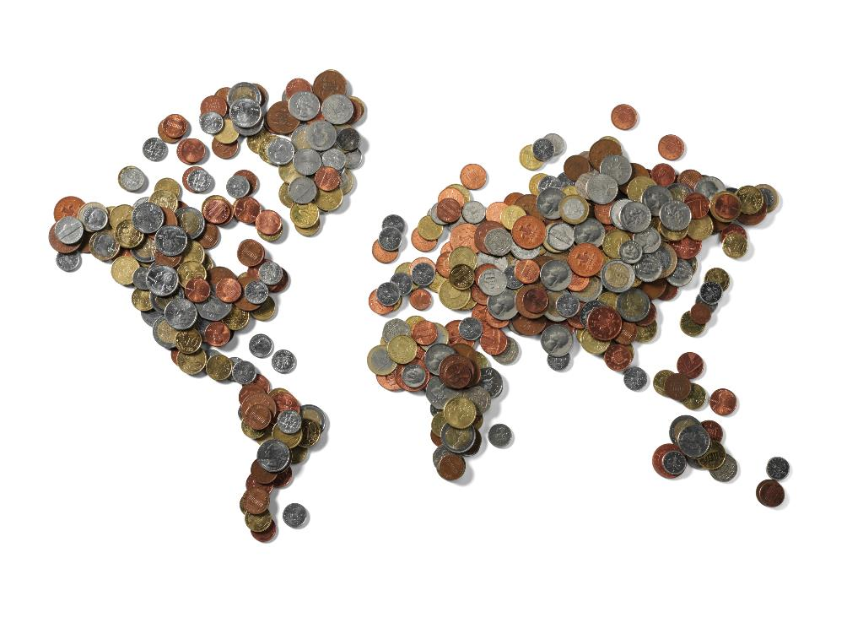
Scenarios that Define an Economic Collapse
Global currency crisis
A global currency crisis involves the loss of value of a major currency that is used in cross-border trade transactions between individuals, corporations, and governments. For example, the US dollar is used as the world reserve currency in the Bretton Woods institutions, which means that if the US dollar depreciates in value, it may trigger a global economic crisis.

Slide 36
How can an SME cope with external financial crises?
When an external crisis jeopardizes markets, SMEs are hit with great force. SMEs face a liability of smallness (Freeman, Carroll, & Hannan, 1983). This means that the smaller the firm the less resources it typically controls, which makes it more vulnerable to external events, such as a crisis hitting the global economy. The liability of smallness often coincides with a liability of newness (Freeman et al., 1983).
New organisations suffer a greater risk of failure than older organizations, because they lack established business models, depend on the cooperation of strangers and have low levels of legitimacy. The liability of newness points to startup companies as a special form of SMEs.
Despite these liabilities, SMEs also have certain characteristics that could help them in times of crisis. Given their smaller size, they tend to be rather flexible when opportunities or threats arise in their environment. Further, the smaller the organization, the closer the decision-makers are to their customers and other stakeholders (Eggers, Hansen, & Davis, 2012). This in turn can provide them with valuable market information that can be helpful when reacting to crises.
Source: Masters of disasters? Challenges and opportunities for SMEs in times of crisis. - Abstract - Europe PMC

Slide 37
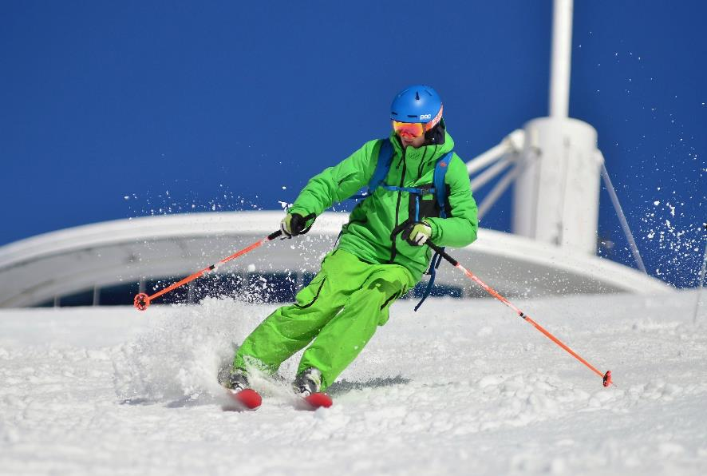
How can an SME cope with external financial crises?
”At this moment it is all about reacting to a sequence of events that has never been so rapid. It is somewhat like slalom skiing, where someone is constantly moving the gates [that we need to pass through]”
Stefan Ingves, Governor of the Swedish Central Bank, in an interview published in Dagens Nyheter, April 2020.

Slide 38
How can an SME cope with external financial crises?
A Study of 456 SMEs in the Norrbotten region, Sweden gives insights to immediate actions taken by SMEs in response to external shock.
READ MORE - Staying alive during an unfolding crisis: How SMEs ward off impending disaster - PMC (nih.gov)
1. Deferred investments (51%)
2. Layoffs/government-funded work allowance (27%)
3. Reduced labour costs (16%)
4. Reduced expenses (12%)
5. Negotiated contracts and terms (8%)
6. Reduced stock (5%)
7. Revenue focused activities (3%)
8. Innovation focused activities (2%)
9. Reduced R&D (1%)
10. Loans (0.5%)
11. Exit (0.5%)

Slide 39
04
Uncertainties Arising from the Market Environment

Slide 40
Market Environment
Market environment is the combination of external and internal factors and forces that affect the company’s ability to establish a relationship and serve its customers.
While some of the factors are in the control of the business, most of these are not and the business has to adapt itself to avoid being affected by changes in these factors. These external and internal factors group together to form the environment in which the business operates.

Slide 41
MARKET ENVIRONMENT
MACRO MARKET ENVIRONMENT
The broader business environment across all markets and industries.
MICRO MARKET ENVIRONMENT
External forces and factors that are directly related to the business. These include suppliers, market intermediaries, customers, partners, competitors and the public

Slide 42
Macro Market Environment
Gross Domestic Product
The gross domestic product, referred to as GDP, is a measure of the total monetary value of goods sold or services enacted within a given quarter or year. GDP is typically measured on a national basis and gives an insight into the strength of the local economy in terms of the value exchanged.
A high gross domestic product signals a healthy economy (and a strong business environment) while a low gross domestic product signals a weak economy (and a poor business environment). Trends in GDP may explain an increase or decline in your SME performance.
The macro-component of the external environment is the broader business environment across all markets and industries. It takes into account the size and nature of entire national (or even international) economies and societies. While this can include political, technological, and other factors, the most relevant ones are all economic.
While many of us are somewhat familiar with these terms, it is important to understand the terminology – KNOWLEDGE IS POWER!
Source: Pestleanalysis.com

Slide 43
Macro Market Environment incorporates
Demography
The word demography refers to the statistical breakdown of a population. As a single number, population on its own — i.e. the number of people living in a given area — doesn’t tell you a lot. However, the wider concept of demography, which also accounts for, for example, the breakdown of a population by age or gender, can tell you a lot about the macro environment. Let’s look at an example. If your product targets over-60s individuals, you’ll be happy to know that there’s a trend of an aging population across the globe, which means people are living longer.
Employment
The fraction of the local or global population that is or isn’t employed. The employment rate is another factor which gives powerful insight into the state of an economy. Again, for most cases: the higher the employment, the better.
Taxes
Taxes are typically set on a national basis. Of course, taxes need no explanation — they’re the cut of your business proceeds taken away by the government. The size of taxes can help you understand your jurisdiction’s monetary policy, and how that relates to the economy as a whole.

Slide 44
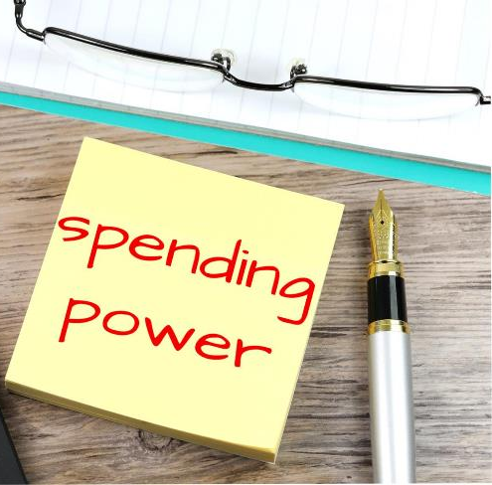
Macro Market Environment incorporates
Consumer Spending
The amount of goods and services end consumers are purchasing every year. While it’s also an economic factor, consumer spending is partially a socio-cultural factor as far as the macro environment is concerned. This is because some cultures are simply more or less prone to buying consumer products, and it might also relate to changes in cultures across time.
Politics
Politics can also be an important factor in the macro environment, especially as related to international trade policies. As an example, if a chosen geographic market doesn’t have trade agreements with your home nation, then your products might be subject to import taxes, which could affect the viability of your business model. In some cases, the political environment might even make it impossible for you to do business in a certain country.
This Photo by Unknown Author is licensed under CC BY-SA

Slide 45
Macro Market Environment incorporates
Technology
Needless to say, technology is a crucial factor in today’s macro environment. Specifically, the technological infrastructure of a nation can be an important element of the macro environment. This may refer to the nation’s technological preferences, the widespreadness of certain technologies, or other such factors.
Ecology
We’re entering an age where the environment is more precious then ever, with depleting amounts of natural resources and growing pollution. As far as macro environment analysis is concerned, ecology is the category of all-important factors that account for this. Other examples of individual ecological factors include weather, terrain flatness, soil fertility and global warming.
Law/Regulation
There’s quite a disparity in regulation across the globe, Take the emerging market of cryptocurrencies. Cryptocurrencies are a new class of financial asset, for which specific rules and regulations haven’t yet been laid out in most countries. A select few countries, however, like Malta or Switzerland, have been quick to regulate the space.

Slide 46
Micro Market Environment
Partners are all the separate entities like banking and insurance companies, transportation companies, brokers, marketing agencies, etc. which conduct business with the SME.
Customers comprise of the target group of the SME.
Competitors are the players in the same market who targets similar customers as that of the SME.
Public is made up of any other group that has an actual or potential interest or affects the company’s ability to serve its customers.
The micro-component of the external environment is also known as the task environment. It comprises external forces and factors that are directly related to the business. These include suppliers, market intermediaries, customers, partners, competitors and the public
Suppliers include all the parties which provide resources needed by the SME.
Market intermediaries include parties involved in distributing the product or service of the organisation.

Slide 47
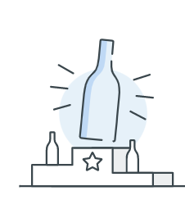
CASE STUDY – NAKED WINES, UK
Naked Wines is an online wine retailer founded by Rowan Gormley in December 2008. In 2015, the company was purchased by Majestic Wine, a British brick and mortar retailer. Naked Wines' customers (called Angels) fund independent winemakers from around the world, in return for wines at self-described "wholesale prices". However, the Financial Times notes that most wines sold by Naked Wines are not available on the retail market, "making direct price comparisons virtually impossible", and most wines are priced "close to usual retail price". They currently ship wine throughout the United Kingdom, United States, and Australia.
RESPONDING TO CHALLENGE
The Naked business responded to challenging conditions and performed well through the 2020 financial year, improving as the year progressed. the more ambitious recruitment of new customers and strong proposition drove 13.7% growth in Group revenue and 14.7% growth in repeat customer contribution.

Slide 48
CASE STUDY – NAKED WINES, UK
The crisis has served to demonstrate the resilience and scalability of the core infrastructure of the business, with their teams rapidly reacting to sustain a high-quality customer experience while modifying the operations and supply chain to safeguard the wellbeing of their people.
INTERVENTION - ENSURING ROBUST SUPPLY CHAIN
In each of the markets in which Naked Wines operates (UK, US and Australia) the office staff started to work remotely, ensuring that their supply chain partners are taking appropriate steps to safeguard their staff. The supply chains were operating efficiently, working within these additional health and safety constraints. As winemakers are considered agricultural, the grape harvest and wine production processes they depend on around the world have been able to continue largely unaffected.
OUTCOME
With the majority of the staff work in their homes, both fixed costs and variable costs have been reduced.
Fixed costs fall to 5.6% of sales in NW US(FY20 8.2%) –
Variable costs per order fell by 18% compared to FY20

Slide 49
CASE STUDY – NAKED WINES, UK
INTERVENTION
Naked Wines believe in planning for the worst whilst aiming for the best and they believe that current conditions, notably the level of consumer uncertainty for the medium term, compel them to be prudent in the capital they retain to address unforeseen circumstances or opportunistic investments.
They have stress tested accelerated growth plans and stock investments against a worst-case scenario for reduced customer spending in future and are satisfied that the business has sufficient resources should they not be able to sell the stock on the planned schedule.
Given the inherent uncertainty in the outlook to the upside and downside they do not believe the business has excess capital to return to shareholders at this time, either through a buyback or dividend, and continue to prioritise capital towards growth and maintaining a robust balance sheet

Slide 50
Inflation, Disruption and Supply Chains
In 2022, inflation and other disruptions have continued to challenge supply chains and analysis shows there is an even stronger correlation now between supply chain disruptions and inflation than before the pandemic. It is important to understand the inflation-disruption cycle to help mitigate these effects with a resilient supply chain built on flexible, cloud-based technologies.
Supply chain drives inflation… inflation drives change in the supply chain
Europe has experienced low inflation for decades. Today’s new inflationary environment is affecting the economic, social and political landscape.

Slide 51
How does supply chain correlate with inflation?
The correlation between supply chains and inflation is three-fold:
Increase in costs
Shortage of materials and services
Greenflation

Slide 52
Increase in costs
Higher energy prices are transferring value in the economy from “energy consumers” to “energy producers”. Yara, a Norwegian fertiliser company and industry leader, curtailed operations at two of its facilities due to the price of natural gas. Many food and beverage companies are facing huge increases in their cost of goods sold.
These are a result of double digit increases of agricultural commodity prices. The FAO Food Price Index reached an all-time high of 159.3 points in March. The Index tracks monthly changes in the international prices of a basket of commonly traded food commodities. It dropped slightly in April but remained 29.8% higher than in April 2021.

Slide 53
Greenflation
As the world moves to electrify everything—from heating to driving—the commodities needed to power the green transition are in greater demand and, therefore, getting more expensive. Take lithium, a crucial element of electric car batteries: its price has increased by more than 1000% since January 2020. The same is true of copper, which is needed in every piece of electrical cable. Until new sources of supply can be brought online, greenflation will be a structural constraint in the short and medium term

Slide 54
Shortage of materials and services
The combination of a rebound in economic activity, and continued strain from supply chain disruptions, is increasing upward pressure on prices. For almost two years now, more than 150 industries have been impacted by chip shortages.
These shortages are affecting the production of a wide range of goods and services including household appliances, smartphones, laptops, printers, gaming consoles, PCs, automobiles, airplanes, and medical devices, among others.
CASE STUDY –supply chain and other interventions
How global supply chain problems can Accelerate Crises
Country: Germany
Industry: Engineering of Special Machinery

Slide 55
Case study continued
The company is run by the second generation and has a turnover of around 5 million euros in normal times. The Covid pandemic has already presented the company with major challenges, but through far-sighted management the impact has been comparatively minor.
The company's machines also use electronic parts / control elements that it buys in. Due to the global "chip crisis", the necessary parts are hardly available - and if they are, then at significantly higher prices than in the past and with considerable delays in delivery.
The contracts with the customers do not provide that price increases can be passed on - and moreover, it is common in many contracts that there are contractual penalties if the machines are not delivered at the agreed time.
Against the background of the delivery problems, it was quickly foreseeable that the company would run into considerable liquidity problems or even face the threat of insolvency if action was not taken quickly.
THE CHALLENGE
- Liquidity reserves already used up during the Covid-Pandemic
- Many existing orders - but under-utilisation in production due to lack of purchased parts
- Impending delivery delays, causing a threat of contractual penalties
As a result: Impending liquidity crisis and threat of insolvency

Slide 56
Case study continued
Intervention – what solution was designed and who were the key actors
The company's management is made up of engineers and has no business management background. A similar situation has not had to be handled in the years since its existence - the uncertainty was correspondingly great. The company's employees were also highly insecure due to the negative experiences from the Covid pandemic and also noticed early on that something was wrong.
Through their network, the management looked for an experienced consultant who was recommended to them with positive references. Together they developed a holistic plan that had the following key components:
Liquidity Plan Together with the management and the consulting firm, a detailed, day-by-day liquidity plan was developed for the next 12 weeks. The liquidity plan was updated daily.
Liquidity Management An authorisation process for purchase orders was implemented. All planned orders and expenditures had to be approved by management and the consultant before they could be made.

Slide 57
Case study continued
Prioritisation of orders based on the degree of completion, delivery dates, missing parts and possible penalties was implemented.
Professionalisation of purchasing Over the years, stable supplier relationships had been built up, but these also led to the same suppliers always being requested. The purchasing department was also instructed to search for suppliers internationally. Some of the customers are large corporations that themselves source electronic components on a much larger scale and therefore have better access to suppliers. This negotiating power was used in part by the customers themselves procuring missing electronic components and making them available to the company.
Renegotiations with selected clients Those customers were identified and suspected of having a particularly urgent need for the machines ordered. With these customers, it was renegotiated that electronic components could be procured at increased costs and that these increased costs could also be passed on to the customer.

Slide 58
Case study continued
Transparency to employees
A weekly staff meeting was introduced in which all employees were informed transparently about the current status.
Revision of the GTCs and the contracts
All existing contractual documents and the General Terms and Conditions were fundamentally revised in order to be able to pass on significant price increases and any component delivery problems to customers in the future or to avoid contractual penalties.
Search for a strategic partner / or investor
At the same time, a strategic partner was sought who would invest in the company, put it on a broader financial footing and also be able to further develop the business model.

Slide 59
Case study continued
OUTCOMES
The measures described were implemented consistently. The potential insolvency risk was averted by the ad hoc measures described. This gave enough time to find a partner who could not only invest in the company, but also develop the company strategically with regard to three central aspects:
- Expansion of customer groups: The new strategic partner has access to international customers from the construction segment with which the company had no contacts before.
- Securing long-term financing: The strategic partner's equity investment secures the company's medium-term financing and creates scope for important investments.
- Further development of the business model: A strategic plan was jointly developed and implemented, which provides for an expansion of the business model with regard to spare parts trade, service and repairs. In this way, the risk of the project business can be diversified and new sources of income are developed.

Slide 60
Back to learning - what can supply chain leaders do?
Managers can take quick actions to contain the impact of inflation on their companies’ profitability. These tactics start with a detailed assessment on their contractual exposure. For years, managers have been living in a low inflation environment where price indexation was not a critical topic. Now, many companies have to assess, analyse and target key elements of their sales or external spend which should be indexed or non-indexed.
Identifying alternative, lower-cost suppliers is also a key short-term fix to deal with inflation. Beyond these more immediate measures, organisations can respond to higher inflation by increasing supply chain resilience.

Slide 61
Resilient supply chains provide businesses with three critical capabilities:
01
Setting up a control tower helps you get the information you need in minutes versus hours and days. A control tower can provide you with end-to-end visibility of your supply chain. This includes tier 1, tier 2 and tier 3 suppliers, so that you can identify and address supply issues before they become shortages.
Visibility
02
Set up a digital twin. It’s a virtual supply chain replica of your company’s operational backbone. With a digital twin, you can simulate your supply chain’s performance across various inflation and volatility scenarios.
Predictability
03
Embed flexibility into your supply chain. For example, identify dual suppliers, develop alternative logistical networks and create alternative designs for your products to help you adapt more quickly.
Flexibility

Slide 62
Inflation and Disruption
The pairing of inflation and disruption is driving massive supply chain changes. The cycle of rising inflation requires a response that combines new technologies and the reskilling of people. This combination of human ingenuity and technology underpins a more resilient supply chain. It doesn’t just help companies manage inflation but can flex to support innovations that drive new sources of growth.

Slide 63
05
Technological Crisis

Slide 64
Freshfields Bruckhaus Deringer interviewed 102 crisis communications specialists who had worked on 2,000 significant reputational risk incidents in 80 countries. The findings are stark:
Only one in five companies had ever simulated what a crisis might look like
Four in 10 had no plan at all
53 percent of companies struck by crisis did not regain their previous share price.
In today's tech-driven age, businesses heavily rely on technology to perform day-to-day functions. So, when that technology crashes, it can be devasting.
Ecommerce sites and software companies can lose millions of potential leads if their servers suddenly break. That's not only a huge loss of potential revenue, but it's also a major hit to the product or service's reputation. But how many companies fully prepare for cyberbreaches, systems failures, or social media attacks?

Slide 65
Preparing for Technology Crisis
Smaller businesses are arguably the most vulnerable to emergencies. In fact, more than 40 percent of small businesses never reopen following a disaster.
Preparing for technology crises requires several steps. Well-funded models, simulations, training and especially back-up communications technology – must all exist before crises hit.
Bandwidth, hardware and applications arrangements with providers should be pre-arranged.
Supply chains must be hardened and cybersecurity plans should extend to a remote access points. The homes of executives and managers should be electronically “hardened” with VPNs, among other hardware and software.
How many companies have made these investments?

Slide 66
Power Outage
Power outages can lead to business disruption and hit at any moment. Infrastructure testing and emergency protocols can help with business continuity when the lights go down. Electric power is one of the most important resources to protect when it comes to critical infrastructure. Power loss is something virtually every business could face at some time, and the results can be disastrous.
A power outage business continuity plan must be included in an organisation's incident response protocols. Organisations can also take various measures to minimise the likelihood of power outages, such as infrastructure testing and ensuring ample backup power supply access.

Slide 67
Minimising business disruption from power outages
Business continuity and disaster recovery (BCDR) and organisational resiliency plans typically include strategies for power outages response and necessary resources. These include local backup power systems, spare power supplies for equipment racks and devices, spare power cables, power connectors and spare power outlets.
The building infrastructure should be periodically inspected
for power protection equipment, including the following:
lightning arrestors;
power conditioners;
surge suppressors;
diverse cable routing in vertical and horizontal raceways and cable paths;
diverse power cable routing into the building; and
service from two different utility power substations.

Slide 68
Cyber security
Impact of cyber attack on a business
A successful cyber attack can cause major damage to the business. It can affect the bottom line, as well as the business' standing and consumer trust. The impact of a security breach can be broadly divided into three categories: financial, reputational and legal.

Slide 69
Cybercrime tops list of external fraud threats faced by businesses globally - PwC
The PwC Global Economic Crime and Fraud Survey spans 1,296 executives from 53 countries and looks at the threat of fraud, the cost of fraud and what companies need to do to develop stronger responses. It found that
half of firms have experienced fraud or financial crime in past two years
of those companies encountering fraud, 70% said there were new incidents of fraud as a result of the disruptions caused by Covid-19.
as attacks become more sophisticated and more frequent, external fraudsters are posing a larger risk to organisations than before.
Rapid shift
Cybercrime overtook customer fraud in this year’s survey as the most common type of fraud by an external perpetrator experienced by organisations, with the rapid shift to digital over the past two years also opening companies up to more risk. The highest incidence of cyberattack was in the tech, media and telecoms businesses, with two-thirds of respondents from this sector saying they had experienced some form of fraud. Businesses have seen a rise in ransomware and phishing attacks.
Cybercrime tops list of external fraud threats faced by businesses globally - PwC – The Irish Times

Slide 70
Economic cost of cyber attack
Cyber attacks often result in a substantial financial loss arising from:
theft of corporate information
theft of financial information (i.e. bank details or payment card details)
theft of money
disruption to trading (i.e. inability to carry out transactions online)
loss of business or contract
In dealing with the breach, businesses will also generally incur costs associated with repairing affected systems, networks and devices.

Slide 71
Best practices for improving small business cyber security
01
Educate employees
02
Implement safe password practices
03
Make sure you’ve got the right partners and platforms
04
Secure your hardware
05
Regularly back up all data

Slide 72
01
Educate employees
As cyber criminals evolve and become savvier, it’s essential to regularly update your employees on new protocols. The more your employees know about cyber attacks and how to protect your data, the safer your business will be.
Send out regular reminders not to open attachments or click on links in emails from people they don’t know or expect; outline procedures for encrypting personal or sensitive information; and train employees to double check if they get rush requests to issue unexpected payments—a common scam.

Slide 73
02
Implement safe password practices
Many data breaches occur due to weak, stolen, or lost passwords. In today’s world of working from your own devices, it’s crucial that all employee devices accessing the company network are password protected. Have employees change their passwords regularly by automatically prompting them to change their passwords every 60 to 90 days.

Slide 74
03
Make sure you’ve got the right partners and platforms
Your cyber security is only as good as the security of the platforms and partners your business depends on. Check the following:
Do you have a WAF (web application firewall) in place – to protect your site?
Is your ecommerce platform PCI-DSS (payment card industry data security standards) Level 1 compliant? That will protect you against digital data security breaches across your entire payment network, not just a single card.
Does your website hosting company have staff that are regularly patching security vulnerabilities – to reduce the likelihood of attacks?
Check to make sure each company computer has antivirus software installed. Even after training employees on how to identify a phishing email, they may be susceptible.

Slide 75
04
Secure your hardware
Data breaches can be caused by physical property being stolen too. If your servers, laptops, cell phones or other electronics are not secured and are easy to steal, you are taking a big risk.
Security cameras and alarms will help, but physically locking down computers and servers will help even more. Whether your employees are working from home, a coworking space, or a traditional office, be sure they understand how to keep their company equipment protected.

Slide 76
05
Regularly back up all data
No matter how vigilant you are with your cyber security strategies, data breaches can still happen.
The most important information to back up is:
Databases
Financial files
Human resources files
Accounts receivable/payable files
Be sure to also back up all data stored on an online drive and check your backup regularly to ensure that it is functioning correctly. Your insurance company may also provide cyber consulting and risk management services, so check with your agent or broker when choosing your cyber insurance coverage. You can also hire an outside expert to evaluate risks!

Slide 77
06
Fuel Crisis

Slide 78
The high price of Europe’s dependence on fossil fuels
The EU has been experiencing one of the worst fuel crises in living memory. The rise in energy prices is dominantly linked to fossil fuels, namely oil and gas. The ECB call it “fossilflation”. Businesses have warned that a "veritable economic crisis" looms due to rising fuel prices. The relentless increase n fuel prices is putting a massive strain on the economy, endangering jobs, growth and prosperity. The growth in fuel prices will have a knock-on effect on the cost of transport, heating and materials. A wage-price spiral is already in motion.
"The key is energy, energy, energy. There is an energy crisis, let's be honest about that, electricity prices are 10 times pre-Covid levels, that is a shock to the system"
Thomas Costerg, senior economist at Pictet Wealth Management.
Inflation has been overwhelmingly driven by soaring energy prices, which explains more than 50% of the increase in consumer prices.

Slide 79
Conflicts and inflation influencing supply chains
Russia, as the world’s second largest producer of oil and natural gas, supplies much of the world with their energy. The EU, which gets 40% of its natural gas and 25% of its oil from Russia, and Asia, are reliant on Russia for supply.
Given this weighty role played by Russia in global production, oil prices have risen dramatically, given the uncertainty caused by the conflict between Russia and Ukraine. Oil prices are at levels not seen in almost a decade. A lengthy conflict in Eastern Europe could further add to rising prices of crude oil.
Because of the conflict between Russia and Ukraine, Russian petrochemical products are being sanctioned against, which in turn has sent market prices higher. Supply chains will need to be reconfigured around alternative supply points where production is still viable.

Slide 80
What does your action plan look like?
As global disruptions remain ever present, staying on top of your supply chain and having end-to-end visibility has never been more important. Building a mid-term plan and identifying possible issues early on, will allow you to plot out your supply chain and will make it easier to react quicker, and make decision based on data versus time.
As inflation continues to rise, companies are forced out of their regular habits. What action can your business take to tackle these challenges ?
Speeding up the energy transition by investing in energy efficiency measures and in renewables is the most effective policy solution to the current spike in inflation. If we are serious about meeting the 2030 and 2050 climate targets, a massive mobilization of green investments will be needed.

Slide 81
07
Crisis Support Approaches

Slide 82
When dealing with an external crisis, the strategy one will use depends on the individual business operation, assets, and needs.
However, there are some core stages that every business should address when developing an external crisis preparedness plan.
Business Impact Analysis (BIA)
Contingency Plans
Continuity Plans

Slide 83
Business Impact Analysis (BIA)
Before you begin building the plan itself, you will first need to conduct a business impact analysis. A BIA seeks to anticipate the effects of various scenarios on a business, such as loss of sales or increased expenses in the event of a natural disaster. This will give you the foundational data you need to build your natural disaster preparedness plan.
There are many ways to conduct a business impact analysis, but a good place to start is a simple BIA questionnaire. A BIA will of course be a greater challenge for larger businesses with more complex operations, as they will need to consider more factors and consult a wider range of insiders for necessary information.

Slide 84
Contingency Plans
A contingency plan is a plan for what to do for the duration of an unusual event, such as a natural disaster. This plan will involve steps that will be taken if the event comes to pass, as well as allocate resources for that possibility.
Examples of contingency plans include:
Planning of evacuation routes;
Installation of emergency equipment;
Investment in backup power sources;
Planning for adjusted operations in the event of loss of workforce;
Insurance that covers potential loss of or damage to inventory or property;
Developing remote work options in case the physical location is compromised.

Slide 85
Continuity Plans
A continuity plan is a plan that accounts for actions that need to be taken for a business to resume operations as efficiently as possible following an unusual event.
Examples of continuity plan measures include:
Allocating additional funds for things like emergency PTO, repairs, and stock replenishment;
Building relationships with a variety of other businesses and suppliers to speed the recovery of supply and business operations;
Developing remote work options in case the physical location remains compromised;
Preparing alternate transportation for goods.

Slide 86
Natural Disaster
In the event of a natural disaster, a business should ideally be prepared to provide information and updates to interested parties such as consumers, stakeholders, employees, community members, and government officials.
This information could include anything from a timeline for the expected return of access to services to an inventory of lost products.
Some measures that may be included in a crisis communications plan include:
Identifying the crisis communications team;
Investing in spokesman training for the crisis communications team;
Setting up a notifications system;
Preparing holding statements;
Offering easy access to the notifications system and contact information.

Slide 87
Employee Assistance and Support
01
Providing transportation;
Providing direct financial assistance;
Offering remote work options;
Expanding flexibility for work hours;
Offering additional PTO;
Expanding access to medical care;
Expanding access to counseling;
Offering care packages;
Offering your premises as an avenue for sheltering in place.
02
In the event of a crisis from external sources, your employees could be negatively impacted in a wide variety of ways, including loss of work hours, loss of personal property, and emotional trauma. By taking care of your employees during this crisis, you will potentially allow them to better do their jobs in the long run, earn loyalty from your employees, and demonstrate ethical business operations to the public. Options for supporting your employees during an external crisis include:
03
04
05
06
07
08
09

Slide 88
Hazard Mitigation
01
Structural improvements;
Adjustments based on professional hazard audits;
Accessibility updates;
Employee training for emergency response;
On-premises adjustments based on government recommendations for crisis/disaster hazard prevention.
Hazard mitigation refers to steps taken to eliminate hazards or reduce the damage caused by them, especially in a specific scenario such as a natural disaster. Hazard mitigation measures for a business may include steps such as:
02
03
04
05

Slide 89
Risk Prioritisation
Risk prioritisation is important because it allows you to determine how much of your resource pool should reasonably be dedicated to each potential risk. For example, a business in Turkey, Greece, Albania, Italy, and Romania (the countries with the highest hazard in Europe) would be wise to allocate a significant portion of their resource pool towards earthquake response, but likely will not substantially benefit from hurricane preparations.
In contrast, a business in Western Germany should likely invest in a floos response plan, but likely will not substantially benefit from earthquake preparations.
As another example, a financial services company would be wise to invest heavily in IT disaster recovery plans while carrying few physical products that they would need to worry about being damaged. Meanwhile, a furniture store would be wise to take steps to protect their physical inventory.
In short, while it is a good idea to cover your bases, you should prioritize risk based on likelihood, as well as the impact that it would have on your business. Deploying data analysis systems to consider environmental, health, and safety risks can provide a structured view of risks and how they should be prioritised for any business.

Slide 90
Risk Management
A risk management plan identifies, analyses, prioritises, and monitors risks, and establishes protocols to address these risks if the occasion arises.
A risk management plan should be a living document that reassesses risks, provides dynamic data analytics, and adjusts the prescribed strategies on an ongoing basis.

Slide 91
To develop an effective risk management plan for external crisis risk, you should take the following steps:
Risk Management
01
Designate a risk management team;
Identify risks;
Prioritise risks;
Determine who would be impacted by the event;
Acquire and deploy risk management information systems and risk analytics software for processing and managing data on an ongoing basis;
06
Analyse relevant data continuously to ensure all processes and plans are up to date and appropriate;
Anticipate potential losses;
Create an easily accessible document outlining the plan;
Clearly outline each risk, the potential damages associated with each risk, the protocols meant to prevent that risk, and the protocols for responding to that risk;
Regularly reassess and update your risk management plan.
02
03
07
04
08
05
09
10

Slide 92
Next Module 3..
A CRISIS THAT COMES FROM INTERNAL FACTORS
www.facebook.com/SECure.ErasmusProject
www.twitter.com/SECure_Project
www.linkedin.com/company/secure-project/
www.smecrisistoolkit.eu

